Slide 1
Academic Pathways
Summer Data Conference
June 2015

Slide 2
Overview
5 Game Changers
Current Academic CIP Codes
Tie to K-12 (Junior Year – ACT Score and iCAP)
8 Academic Pathways
New opportunities for data use

Slide 3
5 Game Changers
Performance Funding
Remediation as a Co-requisite, Not a Prerequisite
Time and Intensity
Block Scheduling
Guided Pathways to Success

Slide 4
Current Academic cips
Ranges from 1 to 48
2-, 4-, or 6-digit CIP
All academic CIPS end in 00 for MS CJCs meaning we currently use a 6-digit CIP with the last two digits being 00
09.0400
First 2 are content areas
Second 2 are general focus
Third 2 are detailed program classifications (used by IHL)

Slide 5
CIP Content areas
01) AGRICULTURE, AGRICULTURE OPERATIONS, AND RELATED SCIENCES.
03) NATURAL RESOURCES AND CONSERVATION.
04) ARCHITECTURE AND RELATED SERVICES.
05) AREA, ETHNIC, CULTURAL, GENDER, AND GROUP STUDIES.
09) COMMUNICATION, JOURNALISM, AND RELATED PROGRAMS.
10) COMMUNICATIONS TECHNOLOGIES/TECHNICIANS AND SUPPORT SERVICES.
11) COMPUTER AND INFORMATION SCIENCES AND SUPPORT SERVICES.
12) PERSONAL AND CULINARY SERVICES.
13) EDUCATION.
14) ENGINEERING.
15) ENGINEERING TECHNOLOGIES AND ENGINEERING-RELATED FIELDS.

Slide 6
CIP Content areas
16) FOREIGN LANGUAGES, LITERATURES, AND LINGUISTICS.
22) LEGAL PROFESSIONS AND STUDIES.
23) ENGLISH LANGUAGE AND LITERATURE/LETTERS.
24) LIBERAL ARTS AND SCIENCES, GENERAL STUDIES AND HUMANITIES.
25) LIBRARY SCIENCE.
26) BIOLOGICAL AND BIOMEDICAL SCIENCES.
27) MATHEMATICS AND STATISTICS.
28) MILITARY SCIENCE, LEADERSHIP AND OPERATIONAL ART.
29) MILITARY TECHNOLOGIES AND APPLIED SCIENCES.
30) MULTI/INTERDISCIPLINARY STUDIES.
31) PARKS, RECREATION, LEISURE, AND FITNESS STUDIES.

Slide 7
CIP Content areas
32) BASIC SKILLS AND DEVELOPMENTAL/REMEDIAL EDUCATION.
33) CITIZENSHIP ACTIVITIES.
34) HEALTH-RELATED KNOWLEDGE AND SKILLS.
35) INTERPERSONAL AND SOCIAL SKILLS.
36) LEISURE AND RECREATIONAL ACTIVITIES.
37) PERSONAL AWARENESS AND SELF-IMPROVEMENT.
38) PHILOSOPHY AND RELIGIOUS STUDIES.
39) THEOLOGY AND RELIGIOUS VOCATIONS.
40) PHYSICAL SCIENCES.
41) SCIENCE TECHNOLOGIES/TECHNICIANS.
42) PSYCHOLOGY.
43) HOMELAND SECURITY, LAW ENFORCEMENT, FIREFIGHTING AND RELATED PROTECTIVE SERVICES.
44) PUBLIC ADMINISTRATION AND SOCIAL SERVICE PROFESSIONS.

Slide 8
CIP Content areas
45) SOCIAL SCIENCES.
46) CONSTRUCTION TRADES.
47) MECHANIC AND REPAIR TECHNOLOGIES/TECHNICIANS.
48) PRECISION PRODUCTION.
49) TRANSPORTATION AND MATERIALS MOVING.
51) HEALTH PROFESSIONS AND RELATED PROGRAMS.
52) BUSINESS, MANAGEMENT, MARKETING, AND RELATED SUPPORT SERVICES.
53) HIGH SCHOOL/SECONDARY DIPLOMAS AND CERTIFICATES.
60) RESIDENCY PROGRAMS.

Slide 9
Classification of instructional programs
09) COMMUNICATION, JOURNALISM, AND RELATED PROGRAMS.
09.01) Communication and Media Studies.
09.0100) Communication, General.
09.0101) Speech Communication and Rhetoric.
09.0102) Mass Communication/Media Studies.
09.0199) Communication and Media Studies, Other.
09.04) Journalism.
09.0401) Journalism.
09.0402) Broadcast Journalism.
09.0404) Photojournalism.
09.0499) Journalism, Other.
09.07) Radio, Television, and Digital Communication.
09.0701) Radio and Television.
09.0702) Digital Communication and Media/Multimedia.
09.0799) Radio, Television, and Digital Communication, Other.

Slide 10
New k-12 data
All students (beginning in the 7th grade) take the iCAP (Individual Career and Academic Plan)
iCAP results place them in one of 16 career clusters
Beginning in the 9th grade their iCAP scores impact their course electives
All juniors will take the ACT (this year it was given on March 3)
So – what does that mean for our community and junior colleges?
We will know in the student’s 11th grade year their career interest and if they are ready for college level work.
ALARM! – before you ask the question – we don’t know yet, but we are working with MDE on it!

Slide 11
16 Career Clusters

Slide 12
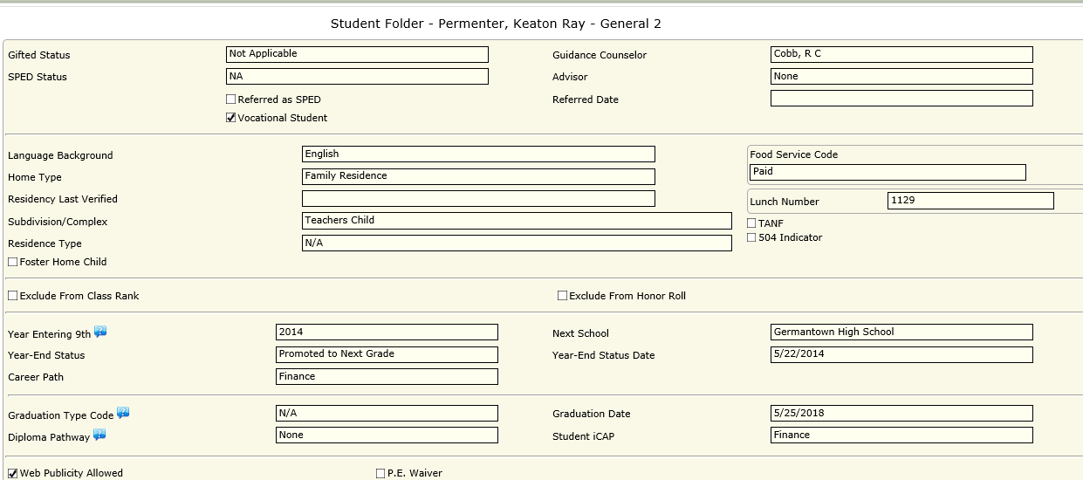
iCAP screen shots
iCAP Career Cluster

Slide 13
iCAP screen shots
iCAP Career Cluster Electives
Personal Finance
Business Finance
Accounting Fundamentals, etc.

Slide 14
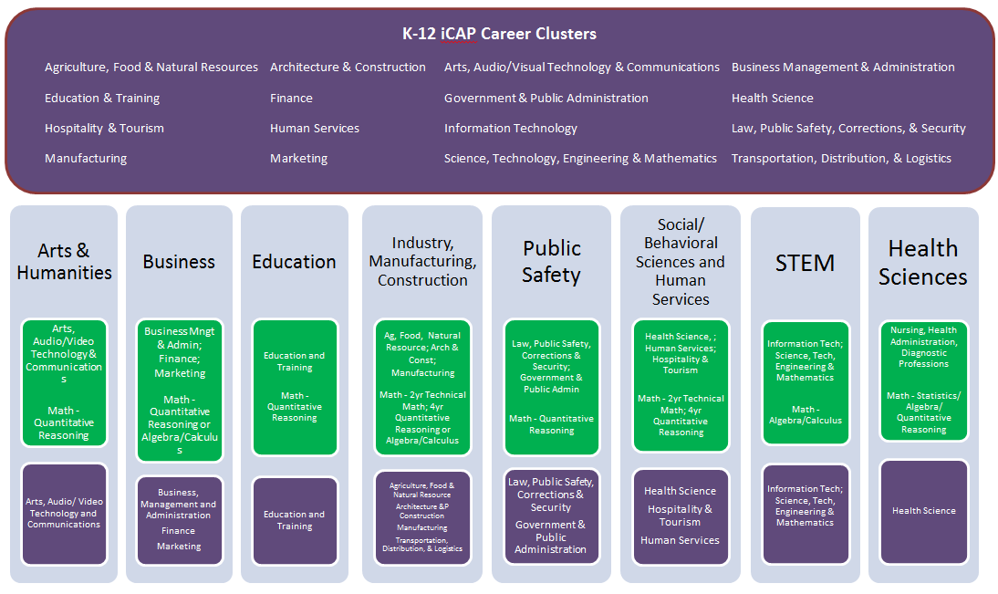
MDE Connection with cjcs

Slide 15
Arts and humanities
09.0000 Communication, Journalism, and Related Programs
09.0100
09.0400
09.0700
09.0900
50.0000 Visual and Performing Arts
50.0100
50.0300
50.0400
50.0500
50.0600
50.0700
50.0900

Slide 16
Business
52.0000 Business, Management, Marketing, and Related Support Services
52.0100
52.0200
52.0300
52.0400
52.1100
52.1200
52.1500

Slide 17
Criminal justice
22.0000 Legal Professions and Studies
22.0300
43.0000 Homeland Security, Law Enforcement, Firefighting and Related Protective Services.
43.0100
43.0200
44.0000 Public Administration and Social Service Professions
44.9900
45.0000 Social Sciences
45.1000

Slide 18
education
13.0000 Education
13.0100
13.1000
13.1200
13.1300

Slide 19
Industry, Manufacturing, & Construction
01.0000 Agriculture, Agriculture Operations and Related Sciences
01.0100
01.0600
01.0800
01.0900
03.0000 Natural Resources and Conservation
03.0500
03.0600
04.0000 Architecture and Related Services
04.0200
04.0600

Slide 20
Health sciences
51.0000 Health Professions and Related Programs
51.0200
51.0600
51.0700
51.0800
51.0900
51.1000
51.1700
51.1800
51.2000
51.2300
51.3100
51.3800
Special Needs Child – ADN

Slide 21
Social, Behavioral and human Sciences
12.0000 Personal and Culinary Services
12.0500
19.0000 Family and Consumer Sciences/Human Sciences
19.0100
19.0700
19.0900
24.0000 Liberal Arts and Sciences, General Studies and Humanities
24.0100
38.000 Philosophy and Religious Studies
38.0100
39.0000 Theology and Religious Vocations
39.0600

Slide 22
STEM
11.0000 Computer and Information Sciences and Support Services
11.0100
11.0400
11.0700
14.0000 Engineering
14.0100
14.0400
14.0900
14.1000
14.3500
14.3900
26.0000 Biological and Biomedical Sciences
26.0100
26.9900
27.0000 Mathematics and Statistics
27.0100

Slide 23
New Data opportunities
Ability to capture the content areas of academic students
Economic development and industry information
Used strategically for funding requests
Incorporated into outcomes and measures
Ability to enroll AA students in structured degree plans and not just individual courses
Supports advisement of students
Prevents students from meandering through courses if classified as undecided or general studies
Ability to capture and use data to recruit and remediate (if needed) while students are in their senior year of high school
Can be as inclusive or as exclusive as you want it to be

Slide 24
Joan Davis Haynes, Ph.D.
Mississippi Community College Board
Associate Executive Director for Academic and Student Affairs
601-432-6106
jhaynes@mccb.edu
www.mccb.edu
The mission of the Mississippi Community College Board is to advance the community college system through coordination, support, leadership, and advocacy.

