Slide 1
Mississippi Integrated Basic Education and Skills Training (MI-BEST)
MS Community College Board
Summer Data Conference 2015
Kenneth Wheatley, Resource Development Director
June 10-11, 2015

Slide 2
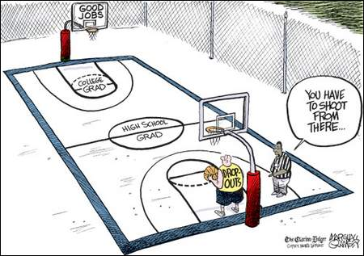

Slide 3
The Need
MS has a high rate of high school dropouts
In 2010 approximately 369,000 (1 in 5) MS adults over 25 years old lacked a high school degree
High poverty rate- 22.3% (Census data)
Low college completion rates only 34% of all college students graduate with a degree from a two or four-year college
Notes:
Source: Census Quick Facts (October 2014)
Racial Makeup: African-American- 37.4%, Caucasian- 59.8%, Hispanic- 2.9%, Asian- 1%
MS Poverty rate is 22.3% compared 14.9% for U.S.
High school graduation rate 81% compared to 85.7% for U.S.
Bachelor’s degree or higher for persons 25+ MS 20% compared to 28.5% for U.S.
Per Capita Income MS= $20,670 compared to $28,051 for U.S.
Median Household Income MS= $38,882 compared to $53,046 for U.S.

Slide 4
The Need
Mississippi’s August 2013 Labor Force Participation Rate was 57.0% compared to 63.2% nationally
Mississippi experienced the greatest decline in Labor Force Participation Rate among Southern states dropping 2.1%
West Virginia had the lowest rate at 53.3% nationally followed by MS and AL at 57%
Notes:
Source: The Council of State Governments 2013
What is the labor force participation rate?
The labor force participation rate is determined by the proportion
of those in the labor force to those in the total civilian, non institutional
population.
To be considered part of the labor force, one must either have a
job or actively be looking for one.
People fall into the category of not in the labor force for a number
of reasons, including because they are retired, disabled or in
school. People also may fall out of the labor force because they are
discouraged and are no longer actively seeking employment.
The labor force participation rate has been on the decline for more
than a decade, and the rate of decline has increased since the Great
Recession began in December 2007.
The labor force participation rate has dropped 2.8 percentage
points since the recession began. In August 2013, the rate hit 63.2
percent—the lowest since 1979.

Slide 5
Definitions
Career Pathways “are linked education and training services that enable students to advance over time to successively higher levels of education and employment in a given industry or occupational sector.”
Combine adult education, training, and postsecondary programs to address the needs of employers
Incorporate multiple entry and exit points
Provide learner-centered instruction and delivery
Assess skills and needs
Incorporate support services
Incorporate quality work experiences
The Alliance for Quality Career Pathways
Source: Funding Career Pathways: A Federal Funding Toolkit for states (Feb. 2015 Revised Edition)
Notes:
CLASP develops and advocates for policies at the federal, state, and local levels that improve the lives of low-income people. In particular, we seek policies that help strengthen families and create pathways to education
and work. For more information, visit www.clasp.org. Established in 1969 as a voice for system change projects that improve the lives of low-income people.
The Center for Postsecondary and Economic Success is a policy and advocacy initiative within CLASP. The mission is to advocate for policies and investments that can increase the number of low-income adults and
disadvantaged youth who earn marketable postsecondary and industry credentials that are essential to opening doors to good jobs, career advancement, and economic mobility
Funding Career Pathways: A Federal Policy Toolkit for States and Local/Regional Career Pathway Partnerships- is a product of the CLASP Center on Postsecondary and Economic Success and was funded by the Bill & Melinda Gates Foundation and Joyce Foundation.

Slide 6
Key Definitions
Other Relevant Career Pathway Definitions:
WIOA, Title II
USDOE Dear Colleague Letter 5/22/15 (Ability to Benefit provisions)
Section 484 (d)(2) of the HEA of 1965, as amended
34 CFR 668.8
US DOL, ETA’s Training and Employment Guidance Letter No. 3-14
Notes:
CAREER PATHWAY. The term “career pathway’’ means
a combination of rigorous and high-quality education,
training, and other services that:
(A) aligns with the skill needs of industries in the economy of the State or regional economy involved;
(B) prepares an individual to be successful in any of a full range of secondary or postsecondary education options, including apprenticeships registered under the Act of August 16, 1937 (commonly known as the “National
Apprenticeship Act”; 50 Stat. 664, chapter 663; 29 U.S.C. 50 et seq.) (referred to individually in this Act as an “apprenticeship”, except in section 171);
(C) includes counseling to support an individual in achieving the individual’s education and career goals;
(D) includes, as appropriate, education offered concurrently with and in the same context as workforce preparation activities and training for a specific occupation or occupational cluster;
(E) organizes education, training, and other services to meet the particular needs of an individual in a manner that accelerates the educational and career advancement of the individual to the extent practicable;
(F) enables an individual to attain a secondary school diploma or its recognized equivalent, and at least 1 recognized postsecondary credential; and
(G) helps an individual enter or advance within a specific occupation or occupational cluster. [Sec. 3(7)]8
Additionally, the Employment and Training Administration’s Training and Employment Guidance Letter No. 3-14 highlights seven elements needed for quality job-driven training. These elements, which all support the career pathways approach, include:
• Working with employers to determine hiring needs and design training programs;
• Offering work-based learning opportunities with employers;
• Making better use of data for accountability and consumer choice;
• Measuring and evaluating employment and earnings outcomes;
• Promoting a seamless progress from one education step to another;
• Breaking down barriers to accessing training and providing support services and guidance;
• Creating regional collaborations between workforce development, education, labor, and nonprofit organizations.

Slide 7
Notes:
The Alliance for Quality Career Pathways identified three core features of a career pathway:
1) Well-connected, quality education and training programs that result in credentials with labor market value and include support services, work experiences, and employment services;
2) Multiple entry points for targeted populations, starting from initial levels of education and connecting to higher levels.
3) Multiple exit points leading to progressively higher levels of employment within a career path.

Slide 8
Essential Career Pathway Elements
8 Elements of Career Pathways:
Sector Strategies
Stackable Educational/Training Options
Contextualized Learning
Accelerated/Integrated Education and Training
Industry-recognized Credentials
Multiple Entry and Exit Points
Intensive Wraparound Services
Designs for Working Learners
Notes:
Career pathways offer a clear sequence of education and training courses and credentials that are built around:
• Sector Strategies aligned with the skill needs of industry sectors important to state and regional economies, where employers are actively engaged in determining skill requirements for employment and career progression in high-demand occupations.
• Stackable Educational/Training Options that include secondary, adult, and postsecondary education and training that is arranged or "chunked" in a non-duplicative progression of courses, clearly articulating one level of instruction to the next. They provide opportunities to earn postsecondary credits and postsecondary credentials that have labor market value.
• Contextualized Learning focused on curricula and instructional strategies that make work a central context for learning and help students attain work-readiness skills.
• Accelerated/Integrated Education and Training combining adult education with postsecondary technical training, giving credit for prior learning, and adopting other strategies that accelerate educational and career advancement of participants.
• Industry-recognized Credentials leading to the attainment of industry-recognized degrees or credentials that have value in the labor market.
• Multiple Entry and Exit Points enabling workers of varying education and skill levels to enter or advance in a specific sector or occupational field.
• Intensive Wraparound Services incorporating academic and career counseling and wraparound support services (particularly at points of transition), and the development of individual career plans.
• Designs for Working Learners to meet the needs of adults and nontraditional students who often need to combine work and study, providing child care services and accommodating work schedules with flexible and non-semester-based scheduling, alternative class times and locations, and innovative uses of technology.
Source: "The Promise of Career Pathways Systems Change: What Role Should Workforce Investment Systems Play? What Benefits Will Results?" Mary Gardner Clagett & Ray Uhalde, Jobs For the Future, December 2011.
6 Team Teaching Models:
Complementary- Supportive
One teacher teaches content; the other provides activities on related topics or on study skills
Monitoring Teacher
One teacher instructs; the other circulates around the room, watching and monitoring student understanding and behavior
Traditional Team Teaching
Two of more teachers actively share the content and skills in the same classroom at the same time with the same group of students
Collaborative Teaching
Teachers work together to teach the material by exchanging and discussing ideas and theories in front of the learners. The course itself uses group learning techniques, such as small-group work, student led discussion, and joint test-taking.
Differentiated Split Class
A class with more than one teacher is divided into small groups according to learning needs. Instructors provide their respective groups with the instruction required to meet their learning needs.
Parallel Instruction
The class is divided into two groups and each teacher is responsible for teaching the same material to his or her smaller group. This model is usually used in conjunction with other forms of team teaching.
For more information: http://www.sbctc.ctc.edu/college/_e-ibestteamteachingmodels.aspx

Slide 9
Synergy
One of MACJC’s legislative priorities for the past six years: Drop-Out Recovery (ABE/GED prep combined with a skills training component);
Legislation drafted in 2013-14 (ultimately not introduced) for a Mississippi Integrated Basic Education and Skills Training Program;
Projects already occurring in at least 7 MS Community Colleges (Co-Lin, Meridian, MS Delta, Northeast, PRCC, Hinds, MSGCCC);
MCCB policy change allowing students without a high school diploma or GED to enroll in approved credit pathway programs to be counted in a college’s reimbursable FTE;

Slide 10
Synergy
Pockets of best practices occurring throughout the state that fit this model, including but not limited to:
Career Pathways (Stackable Credentials; 30/45/60)
Modularization or “chunking” of courses (MS Workforce Advantage)
Prior learning Assessment/Credit by Exam/Articulated Credit (MS Workforce Advantage)
Incorporating national certifications into curriculum (CRC, NCCER, etc.)
Integrated or Team Teaching Strategies (National & Local Expertise Available)
Notes:
6 Team Teaching Models:
Complementary- Supportive
One teacher teaches content; the other provides activities on related topics or on study skills
Monitoring Teacher
One teacher instructs; the other circulates around the room, watching and monitoring student understanding and behavior
Traditional Team Teaching
Two of more teachers actively share the content and skills in the same classroom at the same time with the same group of students
Collaborative Teaching
Teachers work together to teach the material by exchanging and discussing ideas and theories in front of the learners. The course itself uses group learning techniques, such as small-group work, student led discussion, and joint test-taking.
Differentiated Split Class
A class with more than one teacher is divided into small groups according to learning needs. Instructors provide their respective groups with the instruction required to meet their learning needs.
Parallel Instruction
The class is divided into two groups and each teacher is responsible for teaching the same material to his or her smaller group. This model is usually used in conjunction with other forms of team teaching.
For more information: http://www.sbctc.ctc.edu/college/_e-ibestteamteachingmodels.aspx

Slide 11
Planning Grant Progress
All 15 MS Community Colleges are on board
MCCB formed a Statewide Planning Team
Presidents appointed up to 2 Campus Planning Team representatives
MI-BEST Campus Planning Teams established at each college
Mini-grants awards of $7,200 for additional training & technical assistance

Slide 12
Planning Grant Progress
MI-BEST Campus Planning Teams established
Membership includes: faculty, staff, and/or administrators including at least one (1) representative from each of the following areas:
ABE/GED,
Workforce and/or Career & Technical Education,
student financial aid,
student support services,
local business/industry partner(s), and
a community/faith-based organization

Slide 13
First Year AO Results in Review
 | Credentials Awarded | Credits Awarded | Students Enrolled
ALL | 2,641 | 13,382.5 | 2,588
IL | 581 | 4,221 | 419
KS | 1,190 | 4,802.5 | 1,001
KY | 449 | 2,063 | 499
LA | 369 | 1,629 | 451
NC | 52 | 667 | 218
Source: AO College Survey.
For IL, KS, KY, & NC, the first semester was Spring 2012; for LA, the first semester was Fall 2012.

Slide 14
Accelerating Opportunity Kentucky Outcomes
Comparison of AO students & first time students: Spring 2012- Fall 2013
 | AO Students |  | Comparison Group
 | Number | Percent | Number | Percent
Students Enrolled | 1,343 |  | 10,743
Number of students who earned a KCTCS credential(s) | 684 | 50.9% | 923 | 8.59%
Number of credentials earned by students | 863 |  | 1,827
Licenses and industry recognized credentials earned | 177 |  | 230
Number of students who enrolled in subsequent term | 978 | 72.82% | 7,405 | 68.93%
Source: Dr. Vic Adams, VP Workforce Solutions, Southeast KY C&TC, MI-BEST Statewide Planning Team Meeting Presentation 5/22/2014

Slide 15
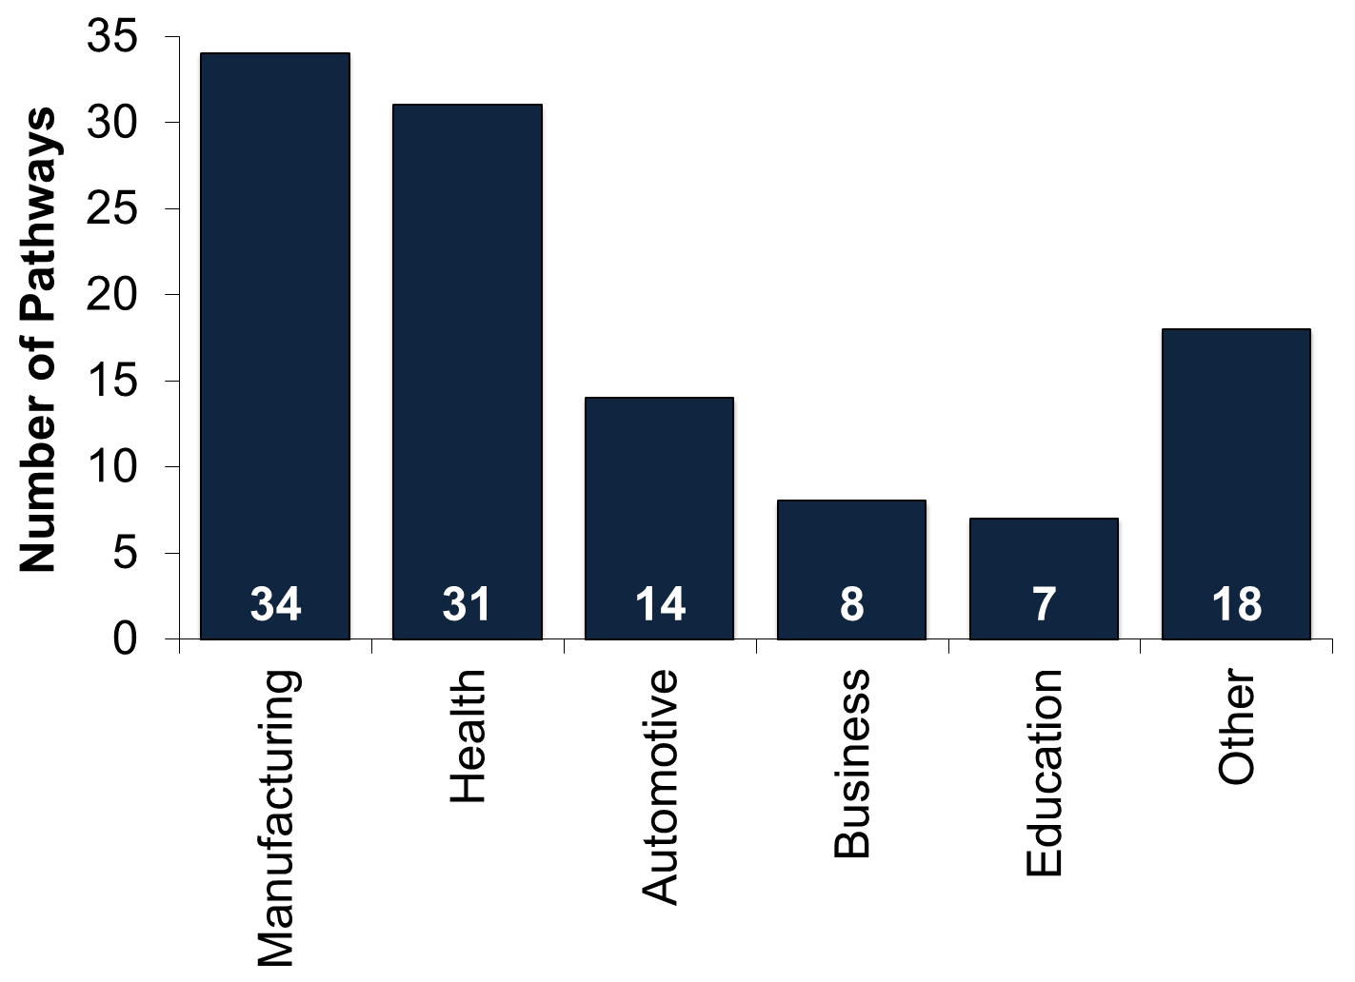
Pathways Active in First Year of Implementation, by Industry Area
Source: AO College Survey

Slide 16
Preliminary Plans
Initial Career Pathways Proposed by Colleges:
Industrial Maintenance
Culinary Arts
Welding
Maritime Craft Technology
Medical Office Assisting
Business Office Assisting
Manufacturing
Healthcare Assisting
Certified Nursing Assistant
Commercial Truck Driving
Commercial & Residential Maintenance

Slide 17
MI-BEST Milestones
High School Equivalency Diploma; AND
Career Readiness Certificate (CRC) (any level); AND
Pertinent industry credentialing for chosen career pathway; AND
At least 15 career pathway credit hours; AND
Completion of a minimum 20 contact hours of employability/life skills training; AND

Slide 18
MI-BEST Milestones
Participation work-based learning opportunities (in chosen pathway or a related field); AND
Employment (in chosen pathway or a related field); OR
Continued postsecondary enrollment towards higher level credential attainment (Certificate or Associate Degree); OR
Enlistment in the military.

Slide 19
Anticipated MI-BEST Outcomes
Total unique number of participants served each semester
Total number of participants completing the prescribed MI-BEST pathway each semester
Total number of participants still retained in their pathway each semester
Number of students earning a high school equivalency diploma each semester
Total number of participants completing fifteen credit hours towards a post-secondary degree
Total number of participants earning a National/Industry-recognized credential in their chosen pathway

Slide 20
Anticipated MI-BEST Outcomes
Total number of participants enrolled in further education after pathway completion
Total number of participants employed in their chosen field after pathway completion
Total number of participants retained in employment after pathway completion
Total number of participants employed at enrollment who received a wage increase post-enrollment
Average earnings of participants employed in their field after pathway completion
Average wage gains of participants employed in their field after pathway completion

Slide 21
Questions?
Mr. Kenneth Wheatley
Director of Resource Development
601-432-6171 kwheatley@mccb.edu
OR
Ms. Nikitna Barnes
Project Coordinator
601-432-6194 nbarnes@mccb.edu

