Slide 1
A REport from the Outcomes-Based (PERFORMANCE) Funding Committee
Mississippi’s Community & Junior Colleges

Slide 2
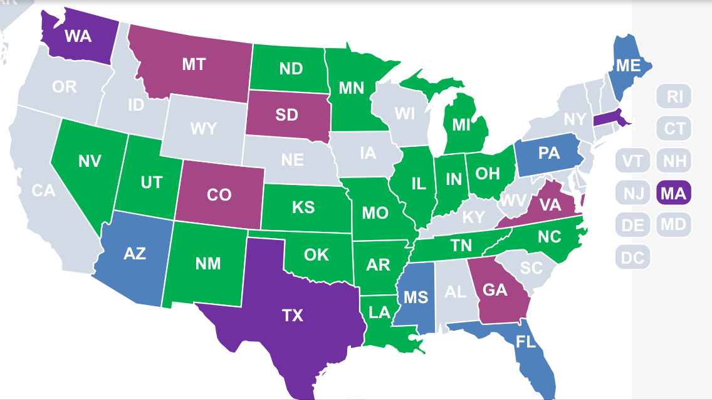
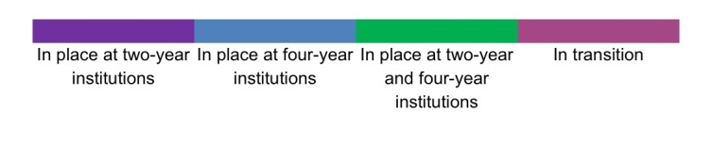
Performance (Outcomes-Based) Funding
Notes:
Twenty-five states—Arizona, Arkansas, Florida, Illinois, Indiana, Kansas, Louisiana, Maine, Massachusetts, Michigan, Minnesota, Mississippi, Missouri, New Mexico, Nevada, North Carolina, North Dakota, Ohio, Oklahoma, Pennsylvania, South Dakota, Tennessee, Texas, Utah and Washington—have a funding formula in place that allocates some amount of funding based on performance indicators such as course completion, time to degree, transfer rates, the number of degrees awarded, or the number of low-income and minority graduates.
Others who have implemented or begun to implement in the past yea OR, CA, KY, WI, SC
Five states—Colorado, Georgia, Montana, South Dakota and Virginia—are currently transitioning to some type of performance funding, meaning the Legislature or governing board has approved a performance funding program and the details are currently being worked out.

Slide 3
Purpose of the Committee
To study and make recommendations to the MACJC (the Presidents’ Association) and ultimately to the MCCB with regard to the creation and implementation of an outcomes-based funding formula to be used to disburse funds to the fifteen community colleges.
This is in direct response to requests by members of both the Senate and House Appropriations Committee.
This work will also be used to inform the Education Achievement Council, which was charged in 2011 (HB 875) with developing a funding mechanism for community and junior colleges and universities based on productivity, in addition to enrollment.

Slide 4
Committee Membership
Dr. Billy Stewart, President - East Central Community College & MACJC Accountability Point Person, CHAIR
Dr. William Lewis, President - Pearl River Community College
Dr. Larry Nabors, President - MS Delta Community College
Dr. Gary Spears, President - Northwest MS Community College
Dr. Fran Cox, Holmes Community College, Past-Chair - Academic Officers Association
Mr. Napoleon Jones, East MS Community College, Chair - Chief Career Tech Officers Association
Mr. Chris Murphy, Northeast MS Community College, Chair - Chief Financial Officers Association
Ms. Cathy Parker, Meridian Community College, Chair - Chief Institutional Research Officers Association
Mr. Raul Fletes, Asst. Executive Director for Research & Effectiveness – MCCB
Ms. Deborah Gilbert, Deputy Executive Director for Finance & Administration – MCCB
Dr. Debra West, Deputy Executive Director for Programs & Accountability – MCCB
EX-OFFICIO (non-voting):
Dr. Eric Clark, Executive Director, MCCB
Dr. Johnny Allen, President – Northeast MS Community College, MACJC Chair
Dr. Clyde Muse, President – Hinds Community College, MACJC Legislative Chair
This effort will be facilitated by Dr. Jimmy Clark and Ms. Martha Snyder, of HCM Strategists. HCM Strategists has worked with numerous state systems across the U.S. in developing outcomes-based funding models.

Slide 5
Time line
Meeting with Senator Burton, Representative Baker | Introduction of Jimmy Clarke; overview of process | April 2, 2PM Capitol
1st Group Meeting - 10AM-2PM | Discuss purpose and process; Adoption of Guiding Principles; Review all existing metrics and benchmarks; discussion of weighting | April 8 (Jackson)
2nd Group Meeting - 10AM-2PM | Determination of potential metrics and weights; | April 28 (Jackson)
3nd Group - 10AM-2PM | Finalization of potential metrics and weights; Discussion of Potential Data Runs | May 21
4th Group Meeting 10AM-2PM) | Review of Data Runs; Discussion of Recommendations | June 8th
MACJC Legislative Workshop | Draft Recommendations to MACJC for discussion | June 14-17 (Tupelo)
MACJC Special Called Meeting | Formula presented to MACJC for Final Approval | July 21 (Tentative)
MCCB Meeting | Formula presented to MCCB for Final Approval | August 21 (Jackson)
Incorporation into Strategic Plans to be submitted to LBO | Colleges and MCCB will need to adjust their strategic plans accordingly. | Month of August
Presentation to Legislature | Proposed Formula to Appropriations Chairs, PEER, LBO | Sept. 1

Slide 6
Guiding Principles
The funding formula will be linked to statewide educational goals and will be aligned to state and system priorities as articulated in “Building a Better Mississippi – The Statewide Strategic Plan for Performance and Budgetary Success” and the Statewide Strategic Plan Benchmarks for Community Colleges.
The funding formula will support the mission of Mississippi’s community colleges to provide a quality educational experience that promotes student access, student completion, and student success.
The funding formula will provide opportunity for all community colleges to succeed by recognizing the priorities and unique needs of the institutions, including the success of underserved student populations and the development of the local workforce.
The funding formula will be reasonably simple to understand and communicate, using a limited number of metrics.
The funding formula will be sustainable and consistent, including applicable metrics grounded in existing data which are reliable, valid, and verifiable.

Slide 7
State Level Accountability Metrics
Statewide Strategic Benchmarks (2014)
Annual Report Cards (2010)
Targeted Performance Measures in Appropriations Bill (1994)
Performance (Outcomes Based) Funding

Slide 8
Metrics
Student Progression/Retention
  Number of students who earned cumulative credit hours towards a degree (i.e., non-developmental) at the 15, 30, 45 credit hour thresholds. (Includes transfer hours towards degree.)
Student Completion
  The total number of university parallel (AA, AS) degrees awarded (three-year rolling average).
  The number of ALL degrees (AA, AS, AAS) and certificates (CC, TC) awarded per 100 FTEs (a three-year rolling average).
Workforce Education
  The total number of career certificates awarded (three-year rolling average).
  The total number of technical certificates awarded (three-year rolling average).
  The total number of AAS degrees awarded (three-year rolling average).
Notes:
Discussions of this proposed measure included:
Listing career technical majors as a line item for recognition
Providing job placement numbers from nSPARC with a narrative to recognize missing data
Attaching a narrative that recognizes that this metric will become more defined as the data capacity grows
Identifying industry recognized credentials that can be validated
Identifying and developing a measure based on credits that are funded
Renaming the bucket so as to provide a more holistic approach to what is being funded as “workforce”

Slide 9
Formula priority weights
Progression (25%)
  15 cumulative degree hrs (6.25%)
  30 cumulative degree hrs (6.25%)
  45 cumulative degree hrs (12.50%)
Completion (50%)
  University parallel degrees (25%)
  Total degrees/100 FTE (25%)

Slide 10
Formula priority weights
Workforce Education (25%)
  Career Certificate (6.25%)
  Technical Certificate (6.25%)
  AAS degree (12.50%)

Slide 11
Student Access (Added Weights)
  Pell Eligibility (0.5)
  Academically Underprepared, based upon placement score (0.5)
  Adult Learners, age 25 and older (0.25)
  Dual Credit/Dual Enrollment (0.25)
  These students get additional points in the formula.
  Students may count in more than one category.
  Once a student hits a category, the weight carries forward, regardless of whether the student’s status changes.

Slide 12
How will outcomes factor into funding?
The recommendation from the Committee is to allocate 5% of the total formula after the 15% base is taken out.
A recommendation will be made, but ultimately the legislature will have to approve.
Notes:
The committee looked at new money, a percentage of the total allocation, and a percentage of the total allocation minus the 15% base.

Slide 13
What does this mean for you????
Data quality is more important that ever.
Additional fields added to primary enrollment file.
  Placement scores
  Pell
  Cumulative credit hrs towards degree
Outcomes will be audited, as well as admission and attendance.

Slide 14


Slide 15
Questions??
Cathy Parker
Director of Institutional Effectiveness & Accountability
Meridian Community College
cparker@mcc.cc.ms.us
Debra West, Ph.D.
Deputy Exec. Director, Programs & Accountability
MS Community College Board
dwest@mccb.edu

