Slide 1
Academic Pathways
Mississippi Community & Junior Colleges

Slide 2
5 game changers for college completion
Performance Funding
Corequisite Remediation
Full-Time is 15
Structured Schedules
Guided Pathways to Success

Slide 3
Prior to Academic Pathways
# of CIPs reported by colleges ranged from 1 to 48
2-, 4-, or 6-digit CIP
09.0400
First 2 are content areas
Second 2 are general focus
Third 2 are detailed program classifications (used by IHL)
Students could enroll in random courses

Slide 4
Classification of instructional programs
09) COMMUNICATION, JOURNALISM, AND RELATED PROGRAMS.
09.01) Communication and Media Studies.
09.0100) Communication, General.
09.0101) Speech Communication and Rhetoric.
09.0102) Mass Communication/Media Studies.
09.0199) Communication and Media Studies, Other.
09.04) Journalism.
09.0401) Journalism.
09.0402) Broadcast Journalism.
09.0404) Photojournalism.
09.0499) Journalism, Other.
09.07) Radio, Television, and Digital Communication.
09.0701) Radio and Television.
09.0702) Digital Communication and Media/Multimedia.
09.0799) Radio, Television, and Digital Communication, Other.

Slide 5
k-12 data
All students (beginning in the 7th grade) take the iCAP (Individual Career and Academic Plan)
iCAP results place them in one of 16 career clusters
Beginning in the 9th grade their iCAP scores impact their course electives
All juniors will take the ACT
So – what does that mean for our community and junior colleges?
We will know in the student’s 11th grade year his/her career interest and if they are ready for college level work.

Slide 6
16 Career Clusters

Slide 7
iCAP screen shots
iCAP Career Cluster Electives
Personal Finance
Business Finance
Accounting Fundamentals, etc.

Slide 8
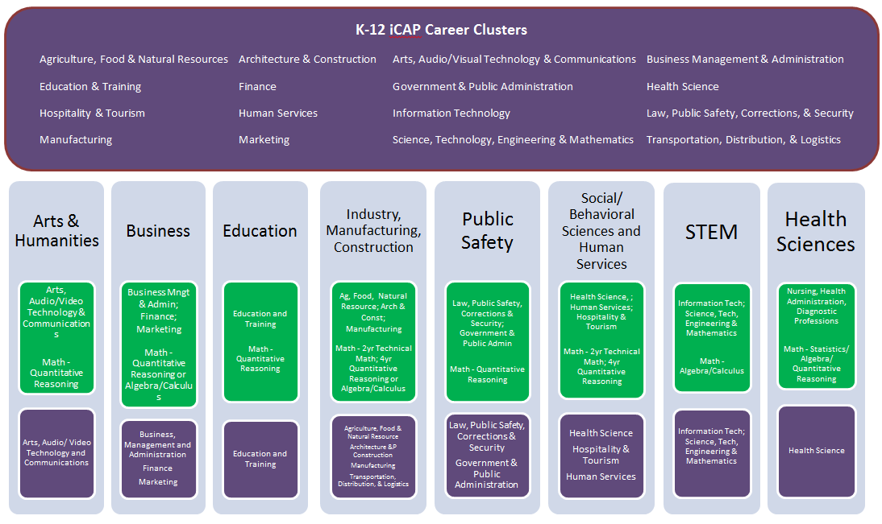
MDE Connection with cjcS

Slide 9
Industry, Manufacturing, & Construction
01.0000 Agriculture, Agriculture Operations and Related Sciences
01.0100
01.0600
01.0800
01.0900
03.0000 Natural Resources and Conservation
03.0500
03.0600
04.0000 Architecture and Related Services
04.0200
04.0600
15.0000 Engineering Technologies and Related Fields
15.0600

Slide 10
STEM
11.0000 Computer and Information Sciences and Support Services
11.0100
11.0400
11.0700
14.0000 Engineering
14.0100
14.0400
14.0900
14.1000
14.3500
14.3900

Slide 11
STEM
26.0000 Biological and Biomedical Sciences
26.0100
26.9900
27.0000 Mathematics and Statistics
27.0100
40.0000 Physical Sciences
40.0100
40.0400
40.0500
40.0600
40.0800

Slide 12
New Data opportunities
Ability to capture the content areas of academic students
Economic development and industry information
Used strategically for funding requests
Incorporated into outcomes and measures
Ability to enroll AA students in structured degree plans and not just individual courses
Supports advisement of students
Prevents students from meandering through courses if classified as undecided or general studies
Ability to capture and use data to recruit and remediate (if needed) while students are in their senior year of high school
Can be as inclusive or as exclusive as the community colleges want
CJC Academic Pathway will be included in the MATT (MS Articulation & Transfer Tool)

Slide 13
Audra Love Kimble
Mississippi Community College Board
Associate Executive Director for Academic and Student Affairs
601-432-6391
akimble@mccb.edu
www.mccb.edu
The mission of the Mississippi Community College Board is to advance the community college system through coordination, support, leadership, and advocacy.

