Slide 1
Auditing Attendance
Raúl Fletes
2016 Summer Data Conference
Mississippi Community College Board
June 8, 2016

Slide 2
Statute
SB 2876 (2016)
  Academic, Technical, Career, Associate Degree Nursing and Associate Degree Allied Health funds shall be disbursed on the basis of prior year full-time equivalency (FTE) of hours generated during the summer, fall and spring semesters for each public community and junior college student actually enrolled and in attendance the last day of the sixth week of each semester, or its equivalent, counting only students who reside within the State of Mississippi. However, associate degree nursing students who reside outside the State of Mississippi may be counted for pay purposes.
Very much the same every year, except for the amounts

Slide 3
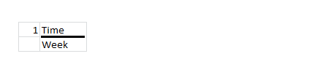
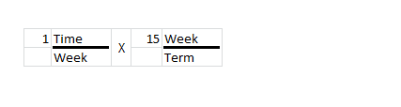
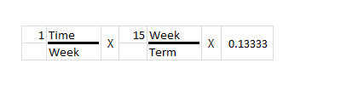
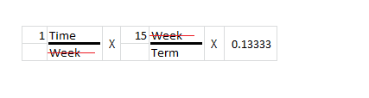
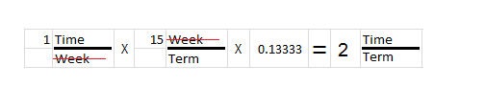
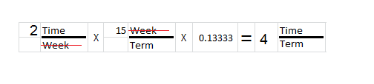
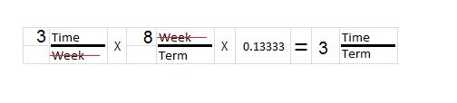
Calculation based on policy
Section 9.2 – Attendance Section
  Based on 100 mins of absence for 750 mins of instruction (one ssch)
    200 mins for 1,500 mins (two ssch) and so on
  That is 100/750=13.33% of a term
Attendance chart simplifies accounting by automatically including the credit hours (as a ratio)

Slide 4
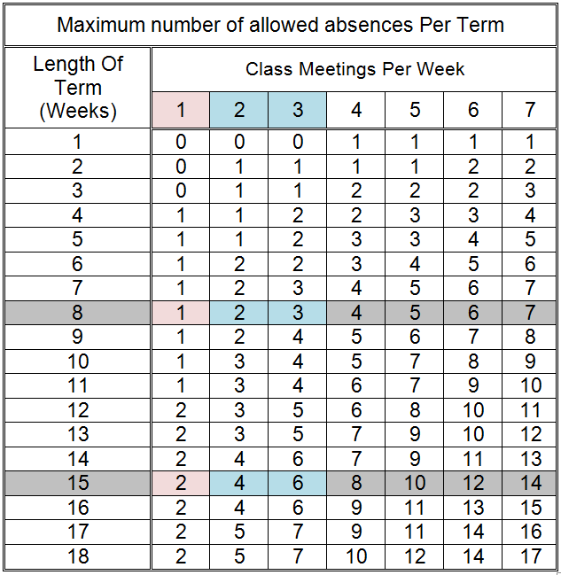
Absence chart

Slide 5
Absent on census date
…and the meaning of examining two extra weeks
Student might have been attending all along but missed classes on that last day of census period
  Then we examine two additional weeks to check for additional absences
    Grace period
  Returned during grace period and had not exceed allowed absences in the census period: set include flag = 1 (request reimbursement)
  Did not return during grace period: set include flag = 0 (do not request reimbursement)
  Period between withdrawals and reinstatements counts like absences, that is, a reinstatement prior to census date can be counted if it does not exceed allowed absences

Slide 6
Auditing attendance
Physically examine each and every roster
  Not an efficient process
  Prone to errors
Piloting an automated process
  Assumes college is taking attendance for ALL students
  Includes ‘Local’ VCC students
    Does not include students from other ‘Hosts’
  Still 100% sampling – just letting the computer do it a bit faster
Will select 10% to 20% of the rosters to physically examine
  Will look for difficult patterns to ensure software programs are correctly interpreting the absence rules

Slide 7
Attendance of Crossed MSVCC
Student in Host college’s SIS
Student is not in Provider college’s SIS
eLC and instructors handle attendance via spreadsheets and emails
Upon student missing more than 2 weeks
  Email to host institution to begin withdrawal process
  Often students are reinstated
    Cat chewed on my internet cable
    Various other valid reasons

Slide 8
Auditing attendance of Crossed MSVCC
The Enrollment Tool (ET) tracks the Last Day Attended
  Does not track attendance
  Does not differentiate between valid on invalid LDA’s
Using the LDA from the ET is the best proxy to attendance so far
  Far from perfect solution
Will continue to use the printouts from ET
Looking for good and easy ideas to implement
  A task force has been created

Slide 9
Electronic Attendance
Set Course File Electronic Attendance Indicator F#17 = 1
For each student enrolled set Student Schedule fields:
  F#8 = Last day attended -- student was present that day
    Example: 03012016
    Leave blank if student did not withdraw
  F#9 = Number of days absent prior and including cutoff date
    Examples: 007, 000, 003, etc.
    Enter 000 if student did not have absences during census period
  F#10 = Student returned on weeks 7 or 8
    Y – student who was absent on actual cutoff date did return
    N – student who was absent on actual cutoff date did not return
    P – student was present on cutoff date

Slide 10
Cutoff date for MSVCC
6 to 18 weeks “and” starting on a Monday and ending on a Sunday
  Take attendance once per week, namely Sunday
  Number teaching days= ((# weeks in a term)*7)-2)
  Ex: (15*7)-2=103 days
  # days for cutoff= (# teaching days)/3
  Ex: (103)/3 = 34.3 days
  Cutoff date=(Start date) + (# days for cutoff)
  Ex: Monday Aug 17 + 34 days= Sunday Sep 20
Rounding: Go to closest Sunday, in this case no need for rounding

Slide 11
6 to 18 weeks “and” starting on a Tuesday and ending on a Sunday:
  Take attendance once per week, namely Sunday
  Number teaching days= ((# weeks in a term)*7)-3)
  Ex: (15*7)-3=102 days
  # days for cutoff= (# teaching days)/3
  Ex: (103)/3 = 34 days
  Cutoff date=(Start date) + (# days for cutoff)
  Ex: Tuesday Aug 18 + 34 days= Monday Sep 21
Rounding: Go to closest Sunday, in this case Sunday Sep 20

Slide 12
4 and 5 weeks “and” starting on a Monday and ending on a Sunday:
  Take attendance twice per week, namely Wednesday and Sunday
  Number teaching days= ((# weeks in a term)*7)-2)
  Ex: (5*7)-2=33 days
  # days for cutoff= (# teaching days)/3
  Ex: (33)/3 = 11 days
  Cutoff date=(Start date) + (# days for cutoff)
  Ex: Monday Aug 17 + 11 days= Friday Aug 28
Rounding: Go to closest Wednesday or Sunday
  Since Friday is equidistant from Wednesday and Sunday then go forward to the Sunday
  In this case Friday cutoff, goes to Sunday

Slide 13
1, 2 or 3 weeks “and” starting on a Monday and ending on a Sunday:
  Take attendance three times per week, namely Wednesday, Friday and Sunday
  Number teaching days= ((# weeks in a term)*7)-2)
  Ex: (2*7)-2=12 days
  # days for cutoff= (# teaching days)/3
  Ex: (12)/3 = 4 days
  Cutoff date=(Start date) + (# days for cutoff)
  Ex: Monday Aug 17 + 4 days= Friday Aug 21
Rounding: Go to closest Wednesday, Friday or Sunday
  In this case no need for rounding

Slide 14
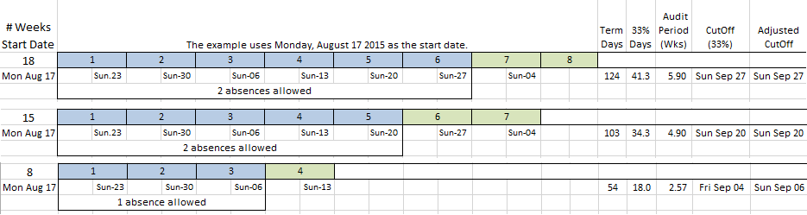
Sample determination of 18, 15 and 8 weeks

Slide 15
Questions

