Slide 1
IHL Strategic Initiatives
Casey C. Turnage, Ph.D.
Heather Morrison
MS Institutions of Higher Learning
Notes:
I am really excited about being here today because this process has been a long one, and my being here signals that the product of this process is about to be ready for use. Before I tell you about the new web-version of the articulation agreement, I want to take an opportunity to give you a bit of history about it.

Slide 2
eTranscripts
MDE says process on track for fall implementation
To be included on eTranscript
Career Clusters
SREB Ready Course(s) completion (80 or higher)
CPAS2 scores
Data Files
For college/university
For State Financial Aid Office

Slide 3
Reverse Transfer Agreement
Started fall 2013 (pilot semester)
Transfer students who earned at least 16 hours at a single MS community/junior college
Notified after completing 62 hours while at an IHL institution
May be eligible for AA degree

Slide 4
Reverse Transfer Agreement
www.mississippi.edu/oasa/reverse_transfer.asp

Slide 5
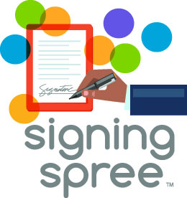
Notes:
I would like to introduce Heather Morrison to speak about this statewide initiative that was launched this week. Heather joined IHL in February. Prior to being at IHL, she was a teacher, school-level administrator, and district-level administrator in Rankin County School District. Her role at IHL is to work on statewide initiatives that bring together K-12, community colleges, and IHL to increase college access.

Slide 6
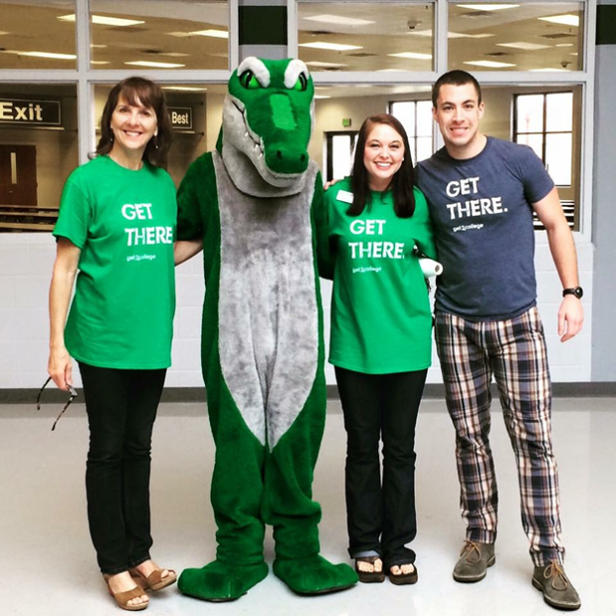
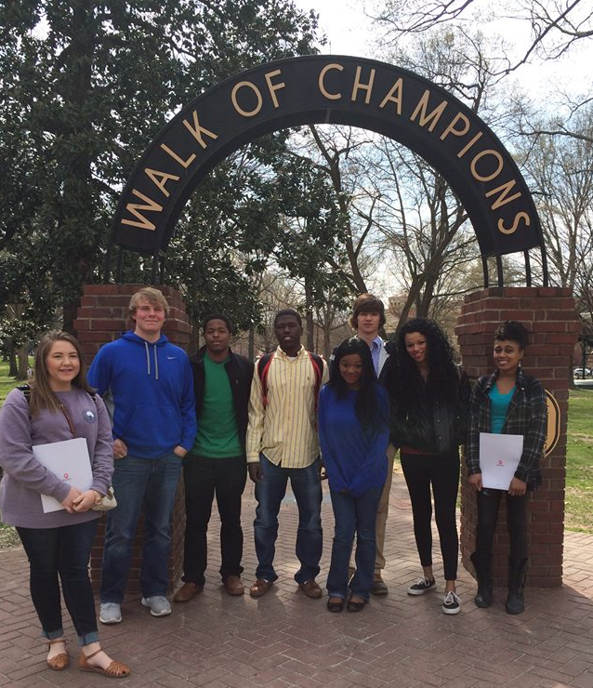
Creating a college going culture

Slide 7
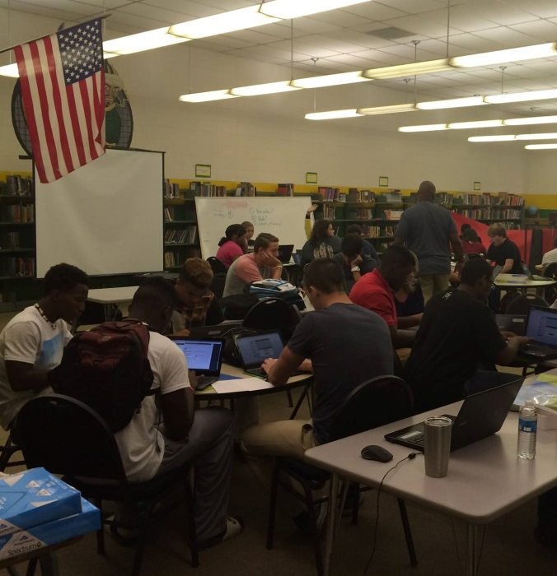
College Countdown MS
Focuses on first-generation students
Occurs in the fall (Oct – Nov)
Takes place during the school day
Requires collaboration (K-12/HE)
Utilizes existing networks and infrastructure
Promotes college-going culture
Uses school personnel and volunteers: low cost
Encourages student preparation and follow-through

Slide 8
Mississippi’s Dual Credit and Advanced Placement Task Force
Review the current state of Dual Enrollment and Advanced Placement policies across our state
Goals are how to ensure access, remove financial barriers, ensure course quality, and transferability of credit
Determine recommendations for Dual Enrollment and Advanced Placement by October 2016

Slide 9
Complete 2 Compete
Notes:
REVERSE TRANSFER
60+ CREDITS EARNED WITH 16+ EARNED AT A SINGLE COMMUNITY COLLEGE
BACCALAUREATE
NO ADDITONAL COURSEWORK….120+ HOURS….GENERIC LIBERAL ARTS DEGREE
SOME COLLEGE AND NO DEGREE
APPROACH LIKELY VARIES BY STUDENT

Slide 10
60% Degree Attainment by 2025
Lumina Foundation, A Stronger Nation through Higher Education, May 2014
Notes:
I’m sure most of you are familiar with Lumina’s Goal 2025 campaign that started in 2009. The goal is to increase the proportion of Americans with high-quality degrees, certificates and other credentials to 60% by 2025.
At the national level, if we continue on the path that we’re on, we are only looking at 49% of the adult population reaching attainment by 2025.

Slide 11
60% Degree Attainment by 2025
Lumina Foundation, A Stronger Nation through Higher Education, May 2014
Notes:
Through the Education Achievement Council, Mississippi adopted the same goal of 60% by 2025. At the current rate, you can see that we are expected to fall short of that goal by about 22%.
IHL and MCCB are working on ways to try to close that gap.

Slide 12
Complete 2 Compete
Statewide Initiative targeting Mississippi adults with some college and no degree

Slide 13
Complete 2 Compete
3 Target Groups:
Former adult students eligible for reverse transfer associate degree with no additional coursework
Former adult students eligible for baccalaureate degree with no additional coursework
Former adult students with some college and no degree
Notes:
REVERSE TRANSFER
60+ CREDITS EARNED WITH 16+ EARNED AT A SINGLE COMMUNITY COLLEGE
BACCALAUREATE
NO ADDITONAL COURSEWORK….120+ HOURS….GENERIC LIBERAL ARTS DEGREE
SOME COLLEGE AND NO DEGREE
APPROACH LIKELY VARIES BY STUDENT

