Slide 1
Update on System Metrics & Strategic Initiatives
Eric S. Atchison
Director of System Analysis, Research, & Enrollment Management
Mississippi Institutions of Higher Learning
MCCB SDC 2016
June 9, 2016

Slide 2
Outline
Overview of the System
Strategic Initiatives
Corequisite Remediation
Finish in Four
Performance Allocation Model
Standardized Workforce Report

Slide 3
Outline
Overview of the System
Strategic Initiatives
Corequisite Remediation
Finish in Four
Performance Allocation Model
Standardized Workforce Report

Slide 4
IHL Overview
Fall 2015 Students: 81,024
AY2015-16 Students: 95,449
Resident Enrollment: 71%
AY2014-15 Degrees: 16,813
FY2015 Research Dollars: $416.6 million
Fall 2015 Employees: 27,746*
*Includes UMMC (35%) and MSU-Ag & Extension
Notes:
STUDENT ENROLLMENT
AT ALL-TIME HIGHS
DUE TO INCREASES IN NON-RESIDENT ENROLLMENT, PARTICULARLY AT MSU, OLE MISS,
TEACH FOR AMERICA PROGRAM AT DSU
RESEARCH DOLLARS
DECLINE IN FEDERAL FUNDS
EMPLOYEES
INCLUDES ALL EMPLOYEES– PART-TIME AND FULL-TIME
EXCLUDES CASUAL EMPLOYEES (EVENT STAFF)

Slide 5
Outline
Overview of the System
Strategic Initiatives
Corequisite Remediation
Finish in Four
Performance Allocation Model
Standardized Workforce Report

Slide 6
Corequisite Remediation
Mississippi Corequisite Institute held at UMMC May 24th
~140 participants
Breakout sessions for English and Mathematics
Canvas course available to continue discussion
Next steps

Slide 7
Outline
Overview of the System
Strategic Initiatives
Corequisite Remediation
Finish in Four
Performance Allocation Model
Standardized Workforce Report

Slide 8
Finish in Four: Mississippi
Additional Degrees Needed to meet 60%:
83,961
Current Annual Degree Production (2010 – 2011)
24,670
Total Additional Degrees Needed (83,961 – 24,670)
59,291
Additional Degrees Needed Annually
1,866
Annual Percent Increase Needed
5.8%

Slide 9
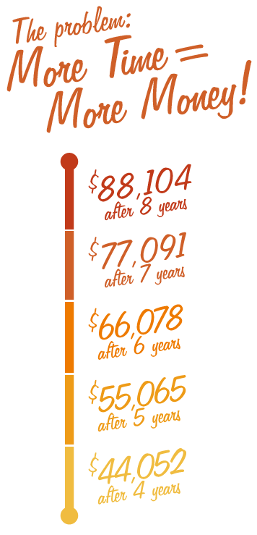
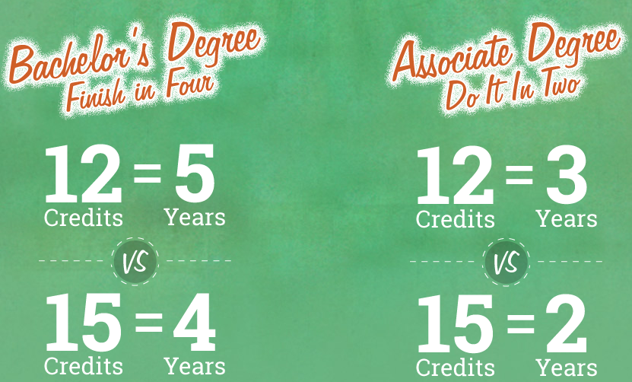
Finish in Four: Mississippi
Finish in
Four Years (K12, IHL)
Four Semesters (CC)
RiseUpMS website :
http://riseupms.com/finishin4/

Slide 15
Finish in Four: Mississippi
Potential Strategies:
Tuition policies:
Tuition Caps
Banded Tuition
Flat Banded Tuition
Discounted Flat Banded Tuition
Institutional Merit Aid
Residence Halls

Slide 16
Outline
Overview of the System
Strategic Initiatives
Corequisite Remediation
Finish in Four
Performance Allocation Model
Standardized Workforce Report

Slide 17
Performance Allocation Model
FY2014 ran model with PERS adjustment
FY2015 ran model
FY2016 used same allocation as FY2015 model; allocated new money (roughly $32 million) on faculty and staff raises
FY2017 3.1% ($24.3 million) decline from FY2016
FY2018 planned implementation with possible adjustments
Notes:
ADJUSTMENTS IN RED
WE VERY WELL KNOW RUNNING AN ALLOCATION MODEL WITH 8 VERY DIFFERENT INSTITUTIONS IS PROBLEMATIC
90 PERCENT OF FUNDING HAS BEEN BASED ON SCHS…..MODEL REWARDS GROWTH
MSU AND UM HAVE BEEN REWARDED IN THE MODEL….PRIMARILY DUE TO THEIR GROWTH IN NONRESIDENT ENROLLMENT
MOVING FORWARD----DSU AND MVSU WILL DO WELL TO MAINTAIN ENROLLMENT----GIVEN THEIR LOCATION IN THE DELTA REGION
MODEL NEEDS TO DO TWO THINGS AT THE SAME TIME…AND THAT IS A CHALLENGE:
REWARD GROWTH WITH MORE RESOURCES
RECOGNIZE STRUGGLES WITH ADEQUATE RESOURCES

Slide 18
Outline
Overview of the System
Strategic Initiatives
Corequisite Remediation
Finish in Four
Affordability Model
Performance Allocation Model
Standardized Workforce Report

Slide 19
Workforce Outcomes by Residency
Cohort | Total # of graduates | 1 year after graduation |  |  | 3 years after graduation |  |  | 5 years after graduation
 |  | # Employed | % Employed | AAE ($) | # Employed | % Employed | AAE ($) | # Employed | % Employed | AAE ($)
In-state
2005-2006 | 1,202 | 932 | 77.54 | 37,500 | 827 | 68.80 | 46,000 | 791 | 65.81 | 50,000
2006-2007 | 1,154 | 889 | 77.04 | 38,000 | 786 | 68.11 | 47,000 | 743 | 64.38 | 52,000
2007-2008 | 1,139 | 862 | 75.68 | 37,000 | 772 | 67.78 | 42,000 | 722 | 63.39 | 48,000
2008-2009 | 938 | 728 | 77.61 | 30,000 | 646 | 68.87 | 36,000 | --- | --- | ---
2009-2010 | 1,121 | 874 | 77.97 | 34,500 | 791 | 70.56 | 41,000 | --- | --- | ---
2010-2011 | 1,213 | 933 | 76.92 | 35,500 | --- | --- | --- | --- | --- | ---
2011-2012 | 1,371 | 1,046 | 76.29 | 33,500 | --- | --- | --- | --- | --- | ---
Out-of-state
2005-2006 | 500 | 101 | 20.20 | 35,000 | 60 | 12.00 | 50,000 | 57 | 11.40 | 58,000
2006-2007 | 552 | 110 | 19.93 | 36,000 | 68 | 12.32 | 43,000 | 58 | 10.51 | 48,000
2007-2008 | 575 | 106 | 18.43 | 31,000 | 62 | 10.78 | 48,500 | 50 | 8.70 | 52,000
2008-2009 | 558 | 107 | 19.18 | 30,500 | 67 | 12.01 | 38,000 | --- | --- | ---
2009-2010 | 553 | 105 | 18.99 | 29,500 | 60 | 10.85 | 42,000 | --- | --- | ---
2010-2011 | 590 | 102 | 17.29 | 32,500 | --- | --- | --- | --- | --- | ---
2011-2012 | 673 | 132 | 19.61 | 31,500 | --- | --- | --- | --- | --- | ---
Notes:
BASED ON A WORKFORCE REPORT BY OLE MISS
AND TWEAKED BY OUR INSTITTUIONAL RESEARCH GROUP
COHORT YEAR
TOTAL NUMBER OF GRADUATES
1 –YEAR, 3-YEAR, 5-YEAR INTERVALS
TABLE BY RESIDENCY….TABLE FOR RESIDENTS AND TABLE FOR NON-RESIDENTS
YOU CAN SEE THE RETENTION DECLINES WHILE THE AVERAGE ANNUAL EARNINGS INCREASES

Slide 20
Workforce Outcomes by Gender
Cohort | Total # of graduates | 1 year after graduation |  |  | 3 years after graduation |  |  | 5 years after graduation
 |  | # Employed | % Employed | AAE ($) | # Employed | % Employed | AAE ($) | # Employed | % Employed | AAE ($)
Male
2005-2006 | 4,374 | 2,583 | 59.05 | 34,732 | 2,202 | 50.34 | 44,078 | 2,048 | 46.82 | 49,385
2006-2007 | 4,237 | 2,450 | 57.82 | 35,652 | 2,100 | 49.56 | 43,996 | 1,971 | 46.52 | 50,519
2007-2008 | 4,269 | 2,393 | 56.06 | 35,127 | 2,072 | 48.54 | 42,099 | 1,934 | 45.30 | 48,667
2008-2009 | 4,186 | 2,438 | 58.24 | 32,280 | 2,071 | 49.47 | 40,564 | --- | --- | ---
2009-2010 | 4,271 | 2,401 | 56.22 | 32,132 | 2,069 | 48.44 | 41,744 | --- | --- | ---
2010-2011 | 4,363 | 2,494 | 57.16 | 33,828 | --- | --- | --- | --- | --- | ---
2011-2012 | 5,146 | 3,009 | 58.47 | 32,520 | --- | --- | --- | --- | --- | ---
Female
2005-2006 | 6,504 | 4,587 | 70.53 | 31,284 | 3,978 | 61.16 | 37,611 | 3,777 | 58.07 | 40,301
2006-2007 | 6,576 | 4,649 | 70.70 | 32,245 | 4,073 | 61.94 | 37,208 | 3,858 | 58.67 | 40,308
2007-2008 | 6,351 | 4,427 | 69.71 | 31,943 | 3,965 | 62.43 | 36,020 | 3,682 | 57.98 | 39,677
2008-2009 | 5,991 | 4,196 | 70.04 | 29,629 | 3,758 | 62.73 | 34,307 | --- | --- | ---
2009-2010 | 6,337 | 4,463 | 70.43 | 30,239 | 3,998 | 63.09 | 35,592 | --- | --- | ---
2010-2011 | 6,588 | 4,577 | 69.47 | 30,870 | --- | --- | --- | --- | --- | ---
2011-2012 | 8,059 | 5,592 | 69.39 | 31,299 | --- | --- | --- | --- | --- | ---
Notes:
SAME FORMAT FOR GENDER
COHORT YEAR
TOTAL NUMBER OF GRADUATES
1 –YEAR, 3-YEAR, 5-YEAR INTERVALS
TABLE BY GENDER….TABLE FOR MALES AND TABLE FOR FEMALES

Slide 21
Workforce Outcomes by Program
A | 430104 | Criminal Justice - BS
 | 430103 | Criminal Justice - MS
 | 440701 | Social Work - BSW
 | 440701 | Social Work - MSW
 | 520201 | Business Administration - BS
 | 310504 | Health, Physical Education and Recreation – BS
 | 260101 | Biology - BS
 | 131209 | Early Childhood Education - BS
 | 090902 | Communications - BA
 | 131206 | Master of Arts in Teaching - MAT
B | 420101 | Psychology – BA
 | 520201 | Management – BBA
 | 521401 | Marketing – BBA
 | 520801 | Managerial Finance – BBA
 | 430103 | Criminal Justice - BSCJ
 | 440701 | Social Work – BSW
 | 141901 | Mechanical Engineering - BS
 | 140801 | Civil Engineering – BS
 | 090401 | Journalism - BA
 | 240102 | General Studies- BGS
Notes:
LIST OF 10 DEGREES FOR THE CUSTOMIZED TABLE
INSTITUTION A WILL GET THAT SAME TABLE FOR ITS 10 DEGREES
INSTITUTION B WILL GET THAT SAME TABLE FOR ITS 10 DEGREES
NOTICE THEY INCLUDE BOTH UNDERGRADUATE AND GRADUATE DEGREES
NO CRITERIA FOR INCLUSION….MOST USED THEIR MORE POPULAR DEGREE PROGRAMS
ON TRACK TO RECEIVE FIRST OF TWO REPORTS IN TWO WEEKS
REQUESTED 2014 DATA AS A PILOT TEST
2015 DATA DUE BY AUGUST 15TH

Slide 22
Questions?
Eric Atchison
601-432-6288
eatchison@mississippi.edu

