Slide 1
Mississippi CJC’s FTE Funding Formulas and the Importance of Accurate Data Summer Data Conference June 9, 2016
Deborah J. Gilbert, CPA
MCCB Deputy Executive Director for Finance and Administration
Jackson, MS
Notes:
This template can be used as a starter file for presenting training materials in a group setting.
Sections
Right-click on a slide to add sections. Sections can help to organize your slides or facilitate collaboration between multiple authors.
Notes
Use the Notes section for delivery notes or to provide additional details for the audience. View these notes in Presentation View during your presentation.
Keep in mind the font size (important for accessibility, visibility, videotaping, and online production)
Coordinated colors
Pay particular attention to the graphs, charts, and text boxes.
Consider that attendees will print in black and white or grayscale. Run a test print to make sure your colors work when printed in pure black and white and grayscale.
Graphics, tables, and graphs
Keep it simple: If possible, use consistent, non-distracting styles and colors.
Label all graphs and tables.

Slide 2
Today’s Overview
1
2
Discuss how the Data you provide impacts certain components of the funding formulas
3
Discuss the importance of providing accurate data
Review the 2 formulas: (1) CJC Support and (2) Career and Technical Funding Formulas
Notes:
This is another option for an Overview slide.

Slide 3
Major Types of Funding Received by the Community and Junior Colleges
State Source Funds:
A. General funds
B. Education enhancement funds
1. One-cent EEF – 14.41% of 1% sales tax revenue
` - 1st year to receive FY 1993
2 . Discretionary one-cent EEF
C. Budget Contingency Funds
D. Capital Expense Funds – 4th year to receive FY 2017
II. Indirect state funds (Workforce from the WET Fund & Career/Tech from MS Dept. of Ed.)
III. Federal funds
IV. Local funds
Student tuition and fees
District taxes
Interest
Fund balance
3

Slide 4
CJC System has Two funding formulas that are primarily FTE based
1. The CJC Support Formula (direct state source fund appropriation from the Legislature) $210,990,085
2. The Career-Technical Education Formula (indirect state funds via MDE that become special funds to MCCB) $26,655,473
4

Slide 5
Support Funding Formula
Background
Let’s take a look at:
Source of funds from the State
How those funds are appropriated by the Legislature
The amount CJCs receive
The amount we allocate through the formula
5

Slide 6
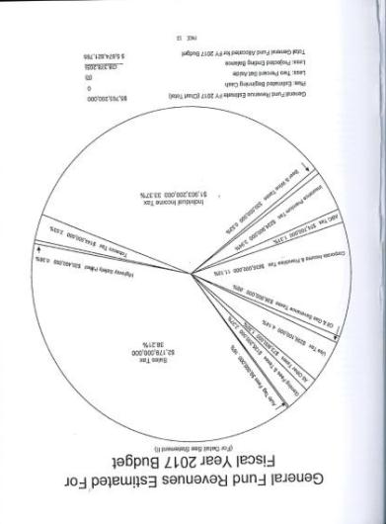
General Fund Est. Revenues by Source FY 2017
Of the $5.67 Billion in GF
Revenues budgeted for FY 2017, Sales Tax and Individual Income Tax account for a majority of those revenues (71.58%).
6

Slide 7
General Fund Appropriations for FY 2017 Budget
Of the Regular General Fund appropriations for
FY 2017, All Educational
Activities accounts for a
majority of the
Expenditures at 54.32%, which is down from close to 60% in previous years.
7

Slide 8
TOTAL EDUCATION GENERAL FUND AS A % OF TOTAL GENERAL FUND APPROPRIATED
FY 2000
FY 2016
FY 2000 FY 2016
39.24% Public Education 39.29%
14.14% IHL 12.02%
4.07% Community/Jr. Colleges 3.85%
57.44% 55.15%
8

Slide 9
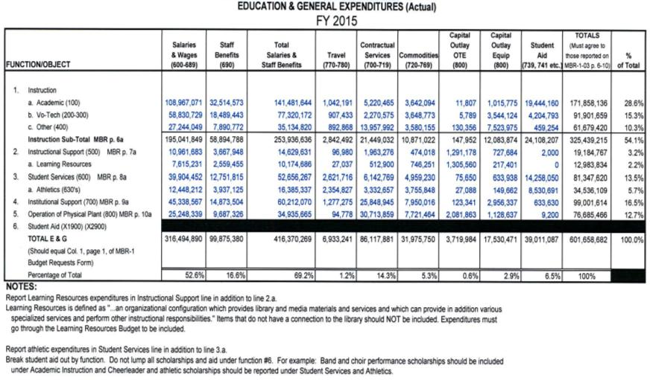
Education & General Expenditures – FY 2015
9

Slide 10
Revenue by Source – FY 2015
System wide
Total $601,658,682
10

Slide 11
Expenditure by Object
FY 2015 System wide
$601,658,682
11

Slide 12
Expenditure by Program
FY 2015 System wide
$601,658,682
12

Slide 13
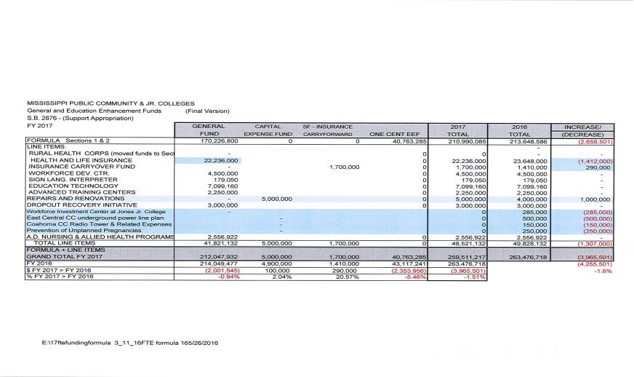
FY 2017 CJC Support Summary Formula and Line Items
Total Formula = $210,990,085
13

Slide 14
State Sources/Funding Formula FY 2017
State sources of $259,511,217 account for a little over 40% of the overall CJC E&G budget, which exceeds $600 million
Of the state sources of $259,511,217, $210,990,085 or 81% will be allocated through the support funding formula in FY 17
Formula $210,990,085
Line Items 48,521,132
Total $259,511,217
14

Slide 15
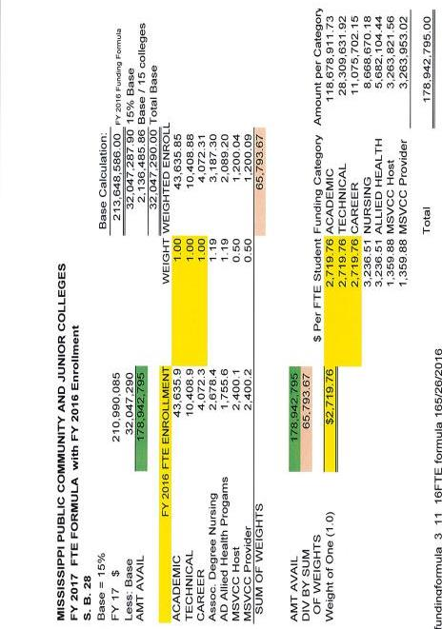
CJC Support Formula Calculation
Weight
Sum of Weights
one
15

Slide 16
CJC Support Formula
16

Slide 17
Support Formula Base
Base Calculation
* Provides fixed, equal amounts to each of the 15 colleges.
* The Base amount is equal to the Prior year funding formula amount (line items not included) times 15%
* The total Base amount is subtracted from the total funding formula amount for the current year to provide the amount available to be distributed via FTE enrollment
17

Slide 18
Full Time Equivalent (FTE)
Semester Credit Hours from the prior year’s Summer, Fall and Summer semesters enrollments are collected
From students “actually enrolled and in attendance the last day of the sixth week of each semester, or its equivalent, counting only students who reside within the State of Mississippi”
(A.D.Nursing is the only exception. Out-of-state A.D. Nursing students must pay out of state tuition, but the semester credit hours they take qualify them for pay purposes.)
In the following categories: 1) Academic, 2) Technical, 3) Career, 4) Associate Degree Nursing , 5) Associate Degree Allied Health and 6) MSVCC
It takes 30 Semester Credit Hours to equal 1 FTE
18

Slide 19
CJC Support Formula
Example: Amount Available = $178,942,795
Academic 43,636 SCH x 1.0 43,636 Technical 10,409 SCH x 1.0 10,409
Career 4,072 SCH x 1.0 4,072
A.D.Nursing 2,678 SCH x 1.19 3,187
A.D. Allied Health 1,755 SCH x 1.19 2,089
MSVCC Host 2,400 SCH x 0.5 1,200
MSVCC Provider 2,400 SCH x 0.5 1,200
---------
Sum of Weights = 68,793
Amount Available to Distribute / Sum of Weights = $210,990,085/65,793.67 = $2,719.76 for a 1.0 FTE = 30 SCH
19

Slide 20
CJC Support Formula
Categories are not necessarily Mutually Exclusive.
Categories Overlap.
For example: NUR credit hours are both Academic and AD Nursing --- simultaneously in the same calculation, i.e. accumulated twice.
20

Slide 21
CJC Support Formula
ADN Example: Student has 3 SCH of NUR 1123.
(SCH = Semester Credit Hours)
Academic 3/30 x 1.0 = 0.10
ADN 3/30 x 1.19 = 0.1190
---------------------------------------------
(Sum of the Weights) = 0.2190
Same is true for AD Allied Health
If the student took NUR 1119, the sum of the weights would be Academic = 0.30 and ADN =0.357, for a total sum of the weights of 0.675.
21

Slide 22
CJC Support Formula
Example:
Student is coded as an NUR Program of Study in PE F27 (CIP 513800), takes 6 hrs. of NUR and 6 hrs. of BIO:
[ 12 Academic x 1.0 + 6 ADN x 1.19 ]
Same student is coded as an LAR (pre-nursing) major in PE, takes same schedule:
[ 12 Academic x 1.0 ]
22

Slide 23
CJC Support Formula
Example:
Bob is coded PE Field 9 (Curriculum) as 1 (AA) and PE Field 27 (Program of Study) as LAR (Liberal Arts) via CIP.
Jessica is coded in PE Field 9 as 1 (AA) and Field 27 (Program of Study) as NUR via CIP (513800).
Bob and Jessica are both enrolled in NUR 2118. Jessica will receive the additional ADN Category 1.19 weight. Bob will NOT.
Note: Correct coding of PE Field 9 (Curriculum) and PE Field 27 (Program of Study ) are necessary for premium reimbursement hours (such as NUR).
23

Slide 24
State Funding for MSVCC
MSVCC PROVIDER semester credit hours are included in the academic, technical or career categories of the formula.
In addition, MSVCC HOST and PROVIDER hours may qualify for FTE funding in a separate section of the formula if the MSVCC student takes less than 12 SCH.
All colleges participating in the MSVCC will agree to basic MSVCC Operational Guidelines and sign a MOU.
24

Slide 25
MSVCC PROVIDER HOURS
All MSVCC PROVIDER semester credit hours (SCH) for the summer, fall, and spring semesters of the prior year are combined with traditional SCH and then divided by 30 to determine the number of Full-Time Equivalent Students.
25

Slide 26
MSVCC PROVIDER HOURS
Academic, technical, and career categories are weighted at 1.0. In FY 17 that will amount to $2,719.76 per FTE student.
MSVCC students must be actually enrolled and in attendance the last day of the sixth week of each semester, or its equivalent, and reside within the state of Mississippi to qualify for funding.

Slide 27
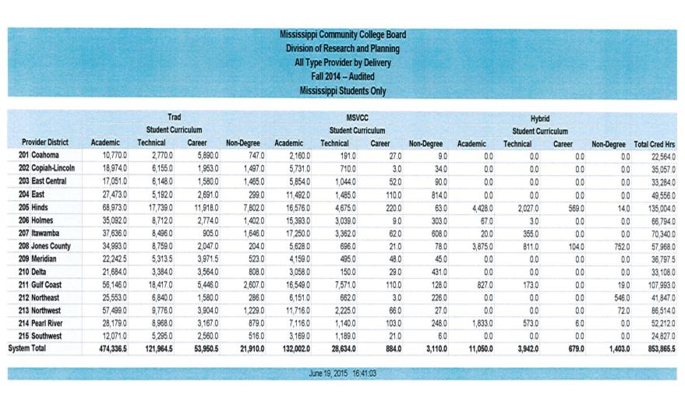
Traditional vs. MSVCC – Fall 2014

Slide 28
Traditional vs. MSVCC SCH Facts – FALL 2014
78.7% of all SCHs generated in the Academic, Technical, and Career sections of the funding formula were Traditional.
____________________________________
78.7% Traditional
19.3% MSVCC
02.0% Hybrid
100.0% Total SCH generated

Slide 29
Formula SCH Facts – FALL 2014
75.6% of all SCHs generated in the Academic, Technical and Career categories of the funding formula are ACADEMIC
___________________________________
75.6% Academic
18.0% Technical
06.4% Career
100% Total A,T,C

Slide 30
MSVCC Provider Credit Hours as a % of Total Provider Credit Hours –Fall 2014
 | MSVCC Provider Credit
Provider | Hours as a % of Total
District | Provider Credit Hours
Coahoma | 10.6%
Copiah-Lincoln | 18.5%
East Central | 21.2%
East MS | 28.1%
Hinds | 15.9%
Holmes | 28.1%
Itawamba | 30.3%
Jones | 11.0%
Meridian | 12.9%
MS Delta | 11.1%
MS Gulf Coast | 22.6%
Northeast MS | 16.8%
Northwest MS | 16.2%
Pearl River | 16.5%
Southwest MS | 17.7%
Total | 19.3%

Slide 31
Part-time Host & Provider
In addition, MSCVCC Host and Provider hours may qualify on the basis of the prior year full-time equivalency of MSVCC hours generated during the summer, fall and spring semesters.
To be considered in this separate section of the formula, the MSVCC student must be taking less than 12 semester credit hours.

Slide 32
Part-time Host & Provider
Those SCH being HOSTED by one institution shall receive funding at the weight of 0.50 and those SCH being PROVIDED by one institution shall receive funding at the weight of 0.50.
If a college hosts and provides a MSVCC student, they receive a weight of 0.50 for the SCH generated in each category for a total weight of 1.0.

Slide 33
CJC Support Formula- MSVCC
Two MSVCC Reimbursement Streams:
1. MSVCC PROVIDER SCH are included in Academic, Technical, or Career in the Support Formula at a weight of 1.0.
2. If the student is part-time in a Fall, Spring (<12 SCH), or Summer (< 6 SCH) term, then
a. HOST college receives the TUITION plus the FTE times 0.5
b. PROVIDER college receives the FORMULA IN ADDITION the FTE times 0.5
33

Slide 34
CJC Support Formula- MSVCC
The MSVCC:
MSVCC Provider: Institution Supplies Instruction
MSVCC Host: Institution Supplies Student
TUITION follows the STUDENT.
FORMULA follows INSTRUCTION (in general (1))
(1) EXCEPT for Part-time MSVCC HOST SCH

Slide 35
Funding Scenario I
If an ICC student takes a 3 credit hour on-line course through Hinds CC, how much tuition will each school get and how much state reimbursement?
ICC (Host) Hinds (Provider)
Tuition (part-time) on average in FY 2016 is Academic, Career or Technical
$118.00 per SCH. Section of the Formula:
$118.00 X 3 hours = $354.00 $2,719.76/30 SCH X 3 hours = $271.98
In addition:
Host/Provider Section of the Formula: Host/Provider Section of the Formula:
3 host hours x ($1,359.88/30) = $135.99 3 provider hours x ($1359.88/30) = $135.99
Total $489.99 Total $407.97

Slide 36
Funding Scenario II
Same ICC student is taking 15 SCH and 3 of those hours are online from Hinds CC:
ICC (Host) Hinds (Provider)
Tuition (full-time) on average in FY 2016 is Academic, Career or Technical
$1,288.00 per semester Section of the Formula:
$1,288/15 hours = $85.87
$85.87 X 3 hours = $257.61 $2,719.76/30 SCH X 3 hours = $271.98
In addition:
Host/Provider Section of the Formula: Host/Provider Section of the Formula:
3 host hours do not qualify for MSVCC 3 provider hours do not qualify for MSVCC
Section funding since student takes more Section funding since student takes more
than 12 hours. $0.00 than 12 hours. $0.00
Total $257.61 Total $201.94

Slide 37
CJC Support Formula- MSVCC
Course File (CF) Field 12 Course Delivery should be coded = 2 MSVCC for the unique MSVCC shared payments to occur.
MSVCC course identifiers uploaded in CF must validate against courses in the Enrollment Tool.

Slide 38
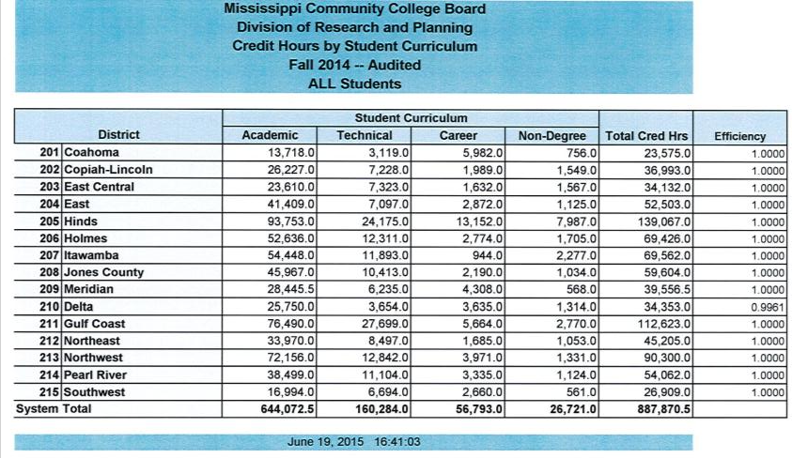
In the Support Funding Formula , all Non-Degree Seeking SCHs generated (after the efficiency is applied) are added to the Academic SCH for allocation purposes.
In the near future, we will see more and more Dual Enrollment occurring in Career and Technical Instruction; therefore, we will need to expand our data fields to separate the dual academic from the career and technical.

Slide 39
Line Items that utilize FTE in their Formulas
There are certain line items within the Support Funding Formula that have their own formulas:
Education Technology (one part is ½ Evenly and ½ FTE Enrollment) $7,099,160
Capital Expense Fund Repairs and Renovations (1/2 on square footage and ½ FTE Enrollment) $5,000,000
Nursing and Allied Health Line Item Appropriation- $1.2M of $2,556,922 is ½ evenly and ½ FTE Enrollment

Slide 40
Career and Technical Ed Formula
The second CJC Funding Formula that is primarily FTE based:
The Career-Technical Education Formula in the amount of $26,655,473 (indirect state funds via MDE that becomes special funds to MCCB)

Slide 41
Contract with MDE
Contract Agreement between Mississippi Community College Board and Miss Board of Education and the Mississippi Department of Education
Three (3) year (July 1, 2015 – June 30, 2018)
MDE grants authority to MCCB to manage the day-to-day operations of post-secondary career and technical education
Provides MCCB authority to sub-contract with the 15 CJC
36

Slide 42
Contract with MDE
Areas of post-secondary management include:
Fiscal Responsibility
Program Approval
Certification
Reporting
Curriculum
Assessment
42

Slide 43
Contract with MDE
1. Fiscal Responsibility:
State Funds to Community and Junior Colleges
Funds designated for career and technical salary
reimbursement shall be allocated by the MCCB
To the community and junior colleges through a
funding formula that distributes funds based on
FTE Enrollments.
This formula also addresses the need for base or
site funds and high cost programs.
Community and junior colleges will request
reimbursement of funds from the MCCB.
Colleges will be required to maintain documentation of expenditures to substantiate the request.
43

Slide 44
Contract with MDE
2. Program Approval
The MCCB will be the sole
approval agency for
post-secondary career and
technical programs.
Prior to assigning the program of study, It is critical that you make sure your Career and Technical
programs are approved and they have
the correct CIP code.
(A list of approved CTE programs by college is in eARS. This year a table was added to the guidelines.)
44

Slide 45
Career/Technical Funding Formula
C/T Funding Formula Committee was authorized and their recommendations were accepted by the MACJC
$26,655,473 – FORMULA amount has not changed since 2004
$1,999,155 or $133,277 each - BASE in C/T Formula = 7.5% where all colleges share evenly
Career & Technical Enrollment ( no academic hours and no A.D.N. hours included)
19 High Cost Programs
45

Slide 46
C/T Funding Formula
19 High Cost Programs
Level 3 = $1,429.11 per FTE
Level 3
Diagnostic Medical Sonography
CIP 510910
2. Dental Hygiene
CIP 510602
3. Physical Therapy Technician/ Assistant
CIP 510806
4. Dental Assistant
CIP 510601
46

Slide 47
C/T Funding Formula
19 High Cost Programs
Level 2 = $952.74 per FTE
Level 2
Occupational Therapist Assistant
CIP 510803
6. Aviation
CIP 470607/08/09
7. Hospitality Admin./Mgt., Gen.
CIP 520901/03/04/120500
8. Cardiovascular Technology
CIP 510901
47

Slide 48
C/T Funding Formula
19 High Cost Programs
Level 2 = $952.74 per FTE
Level 2 (Continued)
9. Respiratory Care
CIP 510908
10. Industrial Maintenance Technology
CIP 470303/470399
11. Surgical Technology
CIP 510909
48

Slide 49
C/T Funding Formula
19 High Cost Programs
Level 1 = $476.37 per FTE
Level 1
12. EMT- Paramedic CIP 510904
13. Construction Equipment CIP 490202
14. Practical Nursing CIP 513901
15. Health Information Technology
CIP 510707
49

Slide 50
C/T Funding Formula
19 High Cost Programs
Level 1 = $476.37 per FTE
Level 1 (continued)
16. Horticulture CIP 010601
17. Clinical/Medical Laboratory Technician
CIP 511004
18. Radiological Technology
CIP 510907 & 510911
19. Truck Driving CIP 490205
50

Slide 52
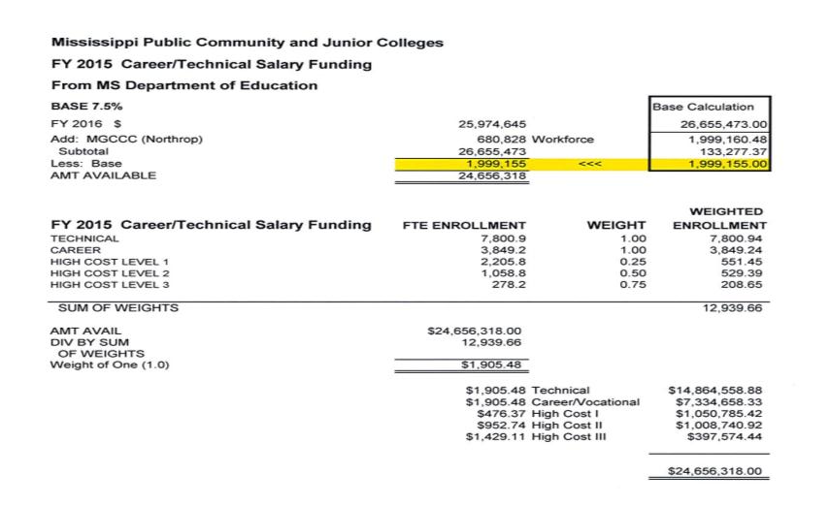
Career & Technical Funding Formula
Sum of Weights
Weight of 1

Slide 53
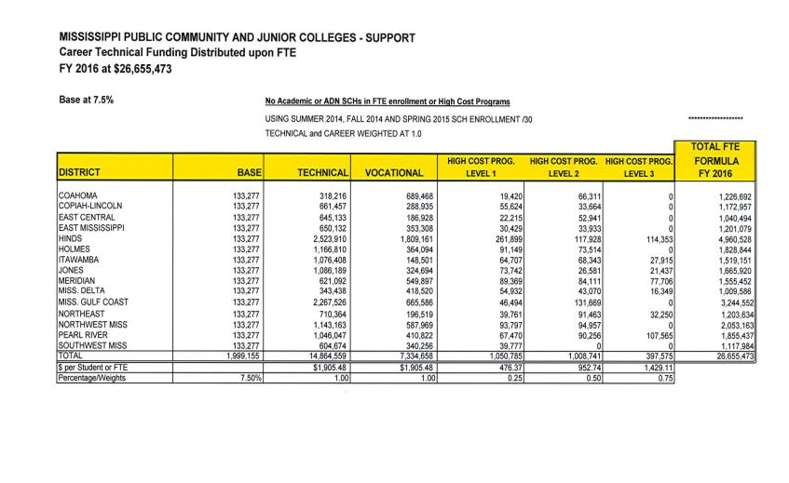
Career and Technical Funding Formula

Slide 54
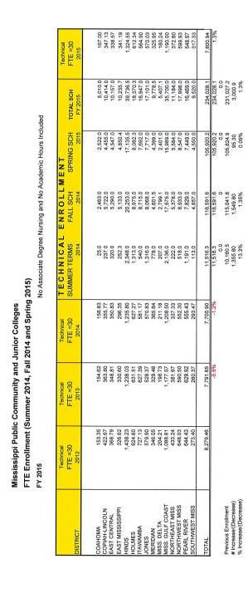
CTE Formula – Technical Enrollment

Slide 55
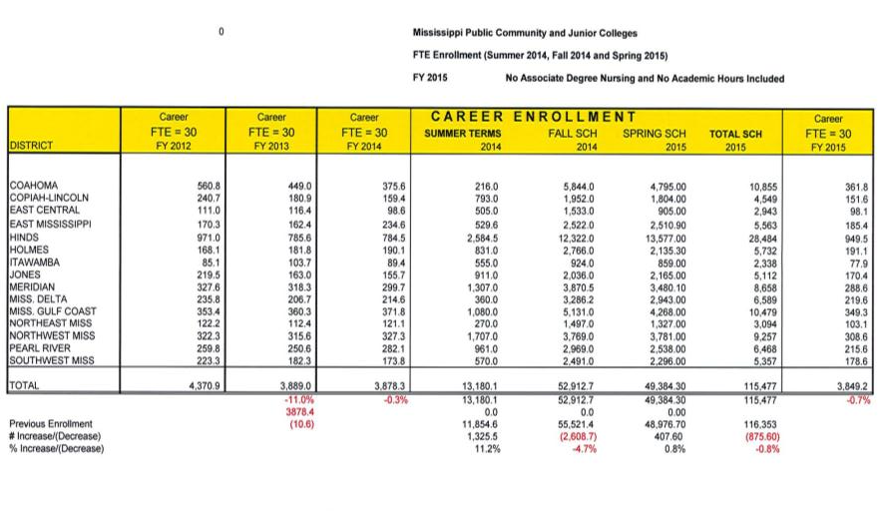
CTE Formula – Career Enrollment

Slide 56
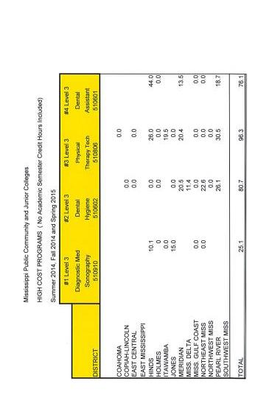
CTE Formula – Level 3 High Cost Programs Enrollment

Slide 57
CTE Formula (funds via MDE)
CTE Funding Formula provides for the 19 High Cost Programs are in addition to CJC Support.

Slide 58
Funding Formula Weights and Per Student Funding
FY 2015
Mississippi Community and Junior Colleges
Funding Formula Weights and Per Student Funding |  |  |  |  | `
FY 2015
 | CJC Support Funding Formula $204,211,986 |  |  |  |  | CJC Career and Technical Funding Formula $26,655,473
Categories | Weight |  | $ Per FTE |  |  | Weight | $ Per FTE
Base | 15% |  | $ 1,930,370.00 | per college |  | 7.50% | $ 133,277.00 | per college
Academic | 1.0 |  | $ 2,606.63 |  |  | N/A | N/A
Technical | 1.0 |  | $ 2,606.63 |  |  | 1.00 | $ 1,925.05
Career | 1.0 |  | $ 2,606.63 |  |  | 1.00 | $ 1,925.05
Associate Degree Nursing | 1.2 |  | $ 3,101.89 |  |  | N/A | N/A
Associate Degree Allied Health | 1.2 |  | $ 3,101.89 |  |  | N/A | N/A
MSVCC Host | 0.5 |  | $ 1,303.31 |  |  | N/A | N/A
MSVCC Provider | 0.5 |  | $ 1,303.31 |  |  | N/A | N/A
High Cost Programs Level 1 | N/A |  | N/A |  |  | 0.25 | $ 481.26
High Cost Programs Level 2 | N/A |  | N/A |  |  | 0.50 | $ 962.53
High Cost Programs Level 3 | N/A |  | N/A |  |  | 0.75 | $ 1,443.79
Definitons:
High Cost Programs Level 1 - | (12) EMT-Paramedic, (13) Construction Equipment, (14) Practical Nursing, (15) Health Information Technology, (16) Horticulture, (17)Medical Lab Technician, (18) Radiodogical Technology, and (19) Truck Driving
High Cost Programs Level 2 - | (5) Occupational Therapy Assistant, (6) Aviation, (7) Hospitality Admin./Mgt., Gen., Cooking/Culinary Arts, (8) Cardiovascular Technology, (9) Respiratory Care, (10) Industrial Maintenance Technology, and (11) Surgical Technology
High Cost Programs Level 3 - | (1) Diagnostic Medical Sonography, (2) Dental Hygiene, (3) Physical Therapy Tech, and (4) Dental Assistant
58

Slide 59
Per Student Funding from Both Funding Formulas – FY 2015
Example - Radiologic Technology CIP 510911 would receive the following dollar amounts for every 1 FTE or 30 semester credit hours generated:
CJC Support Formula: Technical $2,606.63
CJC Support Formula: Associate Degree Allied Health $3,101.89
Career & Technical Formula: Technical $1,925.05
Career & Technical Formula: High Cost –
Level 1 $ 481.26
Total $8,114.83
59

Slide 60
CTE Formula (funds via MDE)
Example:
John PE F9 = 1 Academic. Sam PE F9 = 2 Technical. Deborah PE F9 = 1 Academic.
John takes MAT 1313, CF F13 = 1 Academic. Sam takes DDT 1213 SS F13 = 2 Technical. Deborah takes MST 2243 SS F13 = 2 Technical.
Only Sam’s hours above are paid through the CTE appropriation. Deborah missed out due to being coded as an Academic STUDENT. John was an Academic student taking Academic courses.
PE = Primary Enrollment file
CF = Course File
60

Slide 61
CTE Formula (funds via MDE)
How does this tie to the Enrollment Audit File?
1. PE Field 9 = Curriculum (A, T, C, NDS)
NOTE: If the STUDENT is not classified here as T or C, no CTE distribution occurs even if there is enrollment in CTE courses.
PE Field 27 (Program of Study) must also validate.
2. Course File (CF) Field 3 Identifier ties to SS (Student Schedule) Field 5 Course Identifier. This ties CF Field 13 a Course Type to the student’s schedule. 3. CF 13 is A, T, C and also determines the CTE distribution.
4. CF Field 4 (Course Subject), and
CF Field 5 (Course Number) must be approved by MCCB as an authorized Technical or Career course offering.
61

Slide 62
Performance/Outcomes Based Funding Formula
There is “talk” that the Performance/Outcomes Based Funding Formula will go into effect in FY 2020.
If so, ensuring accurate data in the following areas will be vital:
25% - Student Progression (15, 30, 45 credit hour threshold)
50% - Student Completion (total degrees awarded & degrees awarded per 100 FTE)
25% - Workforce Education (career & technical certificates and AAS degrees)
Student Access – Cumulative, additional weights (Adult Learners, PELL Eligibility, Academically Underprepared and Dual Credit/Dual Enrollment)

Slide 63
Data Accuracy
Your jobs are vitally important.
The accuracy of the data you provide is critical to the proper allocation of millions of dollars to our community colleges.
Inaccurate data provided by one college impacts not only that college, but the remaining 14 colleges.

Slide 64
Resources
“Funding Formula Primer for Data Directors PowerPoint” by David Case June 03,2014
Mississippi Community College Board Support Funding Formula, Career and Technical Funding Formula and FY 2017 Mississippi Budget Request (MBR)

Slide 65
Questions??
Notes:
Is your presentation as crisp as possible? Consider moving extra content to the appendix.
Use appendix slides to store content that you might want to refer to during the Question slide or that may be useful for attendees to investigate deeper in the future.

Slide 66
Deborah J. Gilbert, CPA Deputy Executive Director for Finance and Administration Mississippi Community College Board 3825 Ridgewood Road, Jackson, MS 39211 DGILBERT@MCCB.EDU

