Slide 1
IHL Update
Eric S. Atchison
Director of System Analysis, Research & Enrollment Management
Stephanie Bullock
Complete 2 Compete Project Coordinator
MCCB Summer Data Conference
June 4, 2018

Slide 2
Outline
Least Direct Impact on CJCs
Mississippi Data Management Working Group
General Data Protection Regulation (GDPR)
Data Suppression
IPEDS
Most Direct Impact on CJCs

Slide 3
MS Data Management Working Group
HB 649 – 2017 legislative session
Examination of state’s data resources
120 state agencies identified
Information collected includes, but not limited to: Size of databases, frequency of updates, status of patches, backup procedures, and costs
CJCs were omitted from the study
June 21 deadline to submit survey
December deadline to report to the MS Leg.
Notes:
STUDENT ENROLLMENT
AT ALL-TIME HIGHS
DUE TO INCREASES IN NON-RESIDENT ENROLLMENT, PARTICULARLY AT MSU, OLE MISS,
TEACH FOR AMERICA PROGRAM AT DSU
RESEARCH DOLLARS
DECLINE IN FEDERAL FUNDS
EMPLOYEES
INCLUDES ALL EMPLOYEES– PART-TIME AND FULL-TIME
EXCLUDES CASUAL EMPLOYEES (EVENT STAFF)

Slide 4
General Data Protection Regulation
Adopted by the European Parliament in 2016
Effective as of May 25, 2018
FERPA for EU
Data subjects have control over how their data is handled: right to erasure and data portability requirements
May impact FERPA regulations
Notes:
STUDENT ENROLLMENT
AT ALL-TIME HIGHS
DUE TO INCREASES IN NON-RESIDENT ENROLLMENT, PARTICULARLY AT MSU, OLE MISS,
TEACH FOR AMERICA PROGRAM AT DSU
RESEARCH DOLLARS
DECLINE IN FEDERAL FUNDS
EMPLOYEES
INCLUDES ALL EMPLOYEES– PART-TIME AND FULL-TIME
EXCLUDES CASUAL EMPLOYEES (EVENT STAFF)

Slide 5
Data Suppression
Expanded data delivery to the public domain
Reached out to IPEDS, SREB, and other state system offices
No consensus on data suppression rationale or practice
Piloting data suppression with Student Financial Aid visualization in Tableau
Continuing discussions with CIRO group
Notes:
STUDENT ENROLLMENT
AT ALL-TIME HIGHS
DUE TO INCREASES IN NON-RESIDENT ENROLLMENT, PARTICULARLY AT MSU, OLE MISS,
TEACH FOR AMERICA PROGRAM AT DSU
RESEARCH DOLLARS
DECLINE IN FEDERAL FUNDS
EMPLOYEES
INCLUDES ALL EMPLOYEES– PART-TIME AND FULL-TIME
EXCLUDES CASUAL EMPLOYEES (EVENT STAFF)

Slide 6
IPEDS
No new changes for 2018-19 data collection
Recent technical review panels focused on:
Sub-baccalaureate certificates, distance education, and dual enrollment
Next TRP focuses on the 2020 CIP update
Fall 2018 TRP on finance
Notes:
STUDENT ENROLLMENT
AT ALL-TIME HIGHS
DUE TO INCREASES IN NON-RESIDENT ENROLLMENT, PARTICULARLY AT MSU, OLE MISS,
TEACH FOR AMERICA PROGRAM AT DSU
RESEARCH DOLLARS
DECLINE IN FEDERAL FUNDS
EMPLOYEES
INCLUDES ALL EMPLOYEES– PART-TIME AND FULL-TIME
EXCLUDES CASUAL EMPLOYEES (EVENT STAFF)

Slide 7
Complete 2 Compete
Total applications 10,879
Summer Enrollment 208
Fall Enrollment 166
Associate Degrees Awarded 298
Bachelor’s Degrees Awarded 159

Slide 8
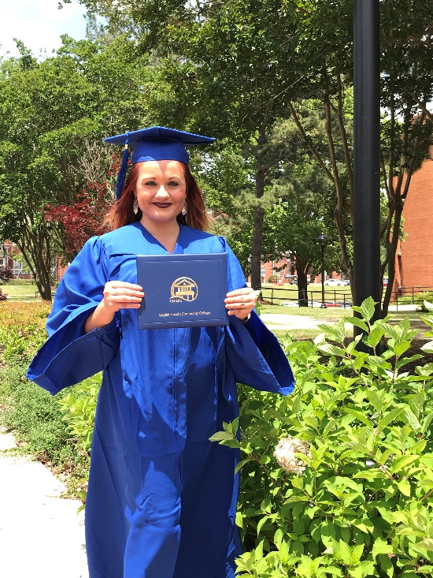
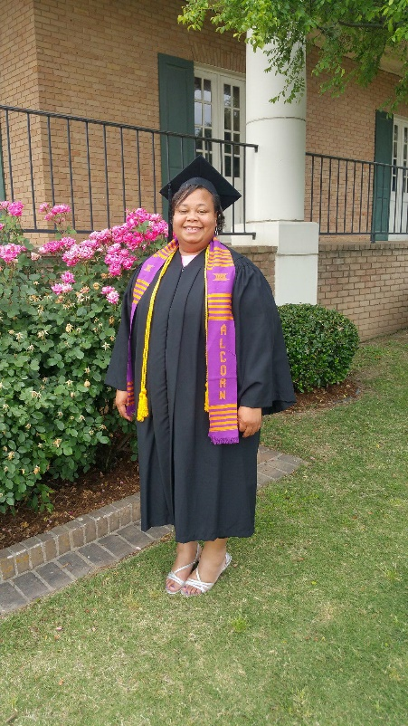
Complete 2 Compete
Success Stories

Slide 9
Complete 2 Compete
Data Reporting
MDHS and Kellogg
Dashboard was not designed to track
Continuing students
With or without coursework
Institutions have the option to opt-out

Slide 10
Questions/Ideas
Eric Atchison
601-432-6288
eatchison@mississippi.edu
Stephanie Bullock
601-432-6051
sbullock@mississippi.edu

