Slide 1
Identification of Homeless Students
June 5, 2019
Quentin Ransburg
Executive Director of Federal Programs
qransburg@mdek12.org

Slide 3
State Board of Education Goals FIVE-YEAR STRATEGIC PLAN FOR 2016-2020
1
2
3
4
5
6
All Students Proficient and Showing Growth in All Assessed Areas
Every Student Graduates from High School and is Ready for College and Career
Every Child Has Access to a High- Quality Early Childhood Program
Every School Has Effective Teachers and Leaders
Every Community Effectively Uses a World-Class Data System to Improve Student Outcomes
Every School and District is Rated “C” or Higher
Notes:
There are 6 board goals that we plan and work around in all of our efforts.
We emphasize the Board’s goals in every presentation because it is critical that our entire public education system is aiming at the same targets.

Slide 4
Agenda

Slide 5
Agenda
Overview and Purpose
Federal Definition of Homelessness for Educators
Data

Slide 6
Federal Law
Subtitle VII-B of the McKinney-Vento Homeless Assistance Act establishes the definition of homeless used by U.S. public schools.

Slide 7
National Data Trends
The number of students identified as homeless and enrolled in schools increased by 3.5% over a three-year span during the 2012-2013 to 2014-2015 school years (National Center for Homeless Education [NCHE], 2016).
Free Application for Federal Student Aid (FAFSA) data indicates that in 2015-2016 school year 31,948 unaccompanied homeless youth applied for financial aid (NCHE, n.d.).

Slide 8
McKinney-Vento Definition of Homelessness
Children who lack a fixed, regular and adequate nighttime residence –
Sharing the housing of others due to loss of housing, economic hardship, or similar reason
*Living in motels, hotels, trailer parks or camping grounds due to lack of adequate alternative accommodations
Living in emergency or transitional shelters
* Review cases individually to determine eligibility.

Slide 9
Homeless Definition (continued)
Living in a public or private place not designed for humans to live
Living in cars, parks, abandoned buildings, substandard housing, bus or train stations, or similar settings
Utilities, infestation, mold and danger should be considered when determining substandard housing
Unaccompanied youth or migratory children in one of the above situations would be homeless

Slide 10
Unaccompanied Homeless Children and Youth
One subgroup of students experiencing homelessness includes those who are considered unaccompanied.
According to the McKinney-Vento Act, the term unaccompanied youth includes a homeless child or youth not in the physical custody of a parent or guardian [42 U.S.C. § 11434a(6)].
Unaccompanied homeless students may face unique challenges related to college and career development, as compared to students who are experiencing homelessness who have parental or guardian support.

Slide 11
Homeless Liaisons
Every LEA must designate a McKinney-Vento liaison who is able to carry out his/her legal duties to ensure the identification, immediate enrollment, and provide needed services for homeless students. McKinney-Vento Act Sec. 722(g)(1)(J)(ii)
Statutory amendments also require local liaisons to inform unaccompanied homeless students of their independent status for purposes of applying for federal student aid under the FAFSA and assist these students in obtaining documentation of this status. Independent students, including unaccompanied homeless youth, do not include parent information on their FAFSA; as a result, independent students’ federal aid packages are calculated based solely on the student’s own income and assets [42 U.S.C. § 11432g(6)(A)(x)(III)]

Slide 12
New Federal Requirement
The U.S. Department of Education (ED) Non-Regulatory Guidance explicitly states that: “The local liaison, along with guidance counselors and other LEA staff tasked with college preparation, should ensure that all homeless high school students receive information and individualized counseling regarding college readiness, college selection, the application process, financial aid, and the availability of on-campus supports” (United States Department of Education, 2016a, p. 48).”

Slide 13
New Federal Requirement
Statutory amendments also require local liaisons to inform unaccompanied homeless students of their independent status for purposes of applying for federal student aid under the FAFSA, and assist these students in obtaining documentation of this status. [42 U.S.C. § 11432g(6)(A)(x)(III)]

Slide 14
Ways to Partner
Know how to contact school district homeless liaisons - https://www.mdek12.org/OFP/Title-IX-Part-A
Designate a Homeless Point of Contact at your college/university
Become familiar with the educational definition of homelessness and barriers faced during their educational journey

Slide 15
McKinney-Vento Data

Slide 16
McKinney-Vento Data Collection
Homeless data is collected in the Mississippi Student Information System (MSIS) database from the Local Educational Agency’s (LEAs) School Application Package (SAP).
Data is submitted monthly from the SAP that produces a student roster, and populates each student’s information on the Homeless Service Provided and Homeless Barriers screens.

Slide 17
Contact Information
Captures the district’s personnel contact information and the homeless liaison. As stated in the National Association for the Education of Homeless Children and Youth law, homeless liaisons are required to be identified for each LEA. The liaison may be a coordinator for the Federal programs, as a local educational agency liaison for homeless children and youths.

Slide 18
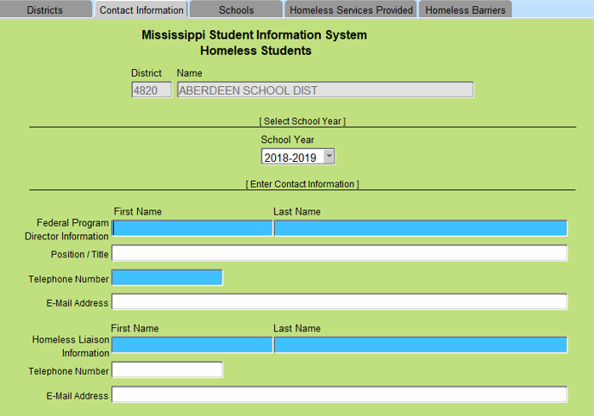
Contact Information Screen
Homeless liaisons information is required.

Slide 19
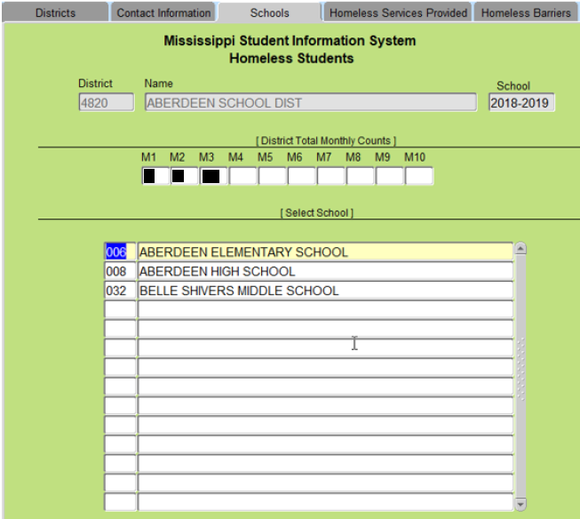
Schools Screen
District monthly counts are captured.

Slide 20
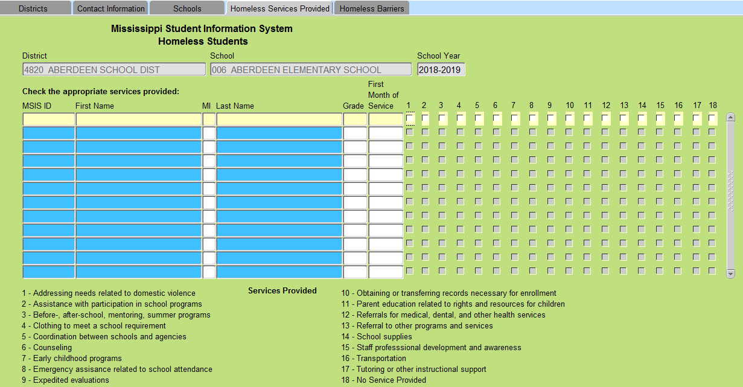
Homeless Services Provided Screen
Multiple services provided is captured.

Slide 21
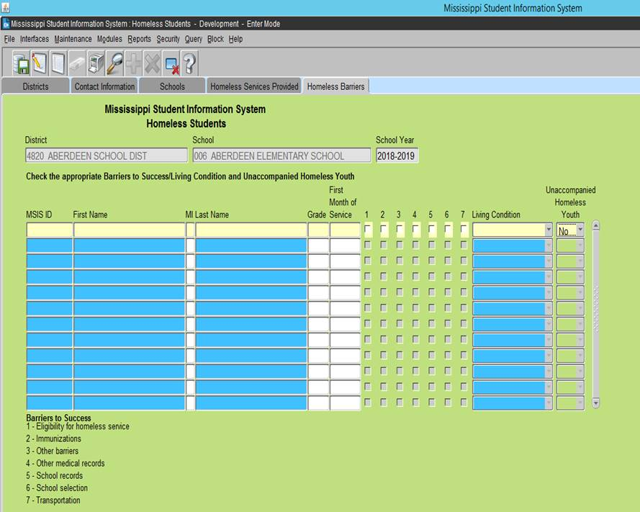
Homeless Barriers Screen
Barriers screen captures the barriers to success, living condition and if the student is an unaccompanied homeless youth.
Living condition includes:
Doubled-up
Hotels or Motels
Shelters
Unsheltered

Slide 22
Reporting Homeless
MDE is required to submit federal reports, which includes services provided and barriers confronted by homeless students.

Slide 23
Mr. Quentin Ransburg, Executive Director
Office of Federal Programs
Mrs. Judy Nelson, Bureau Director
District and School Support
Mrs. Tiffany Jones
Homeless/Neglected and Delinquent Coordinator
601.359.3499
federalprograms2@mdek12.org

