Slide 1
Mississippi High School Diploma Options
Audra Love Kimble
Assistant Executive Director for Academic & Student Affairs
Mississippi Community College Board
akimble@mccb.edu
June 2019

Slide 2
options for all High School students
Beginning with 2018-2019 class of high school freshmen
Graduating Class of 2022
Traditional Diploma
Alternate Diploma
Plus Endorsement Options:
Career & Technical Endorsement
Academic Endorsement
Distinguished Endorsement
For students with a Significant Cognitive Disability (SCD)
(about 1% of the student population)
Not equivalent to a traditional HS diploma
Not recognized by postsecondary institutions for admissions

Slide 3
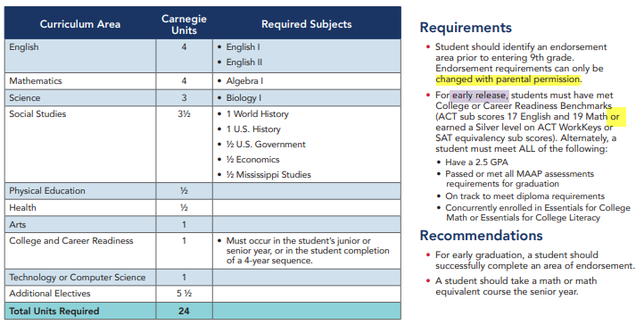
Traditional Diploma Option
Notes:
MAAP Assessments
Algebra I
Biology I
English II
US History
Beginning with school year 2014-2015, students may graduate by passing the course and meeting one of the following options:
Pass the applicable end-of-course Subject Area Test
Use the end-of-course Subject Area Test score with the overall course grade (For seniors in 2014-2015 and 2015-2016 only. Starting in the 2016-2017 school year, SATP scores will constitute 25 percent of a student’s final grade.)
Obtain a score of 17 or higher in the specific subject area on the ACT.
Earn a C or higher in an entry level, credit-bearing dual enrollment/dual credit /college credit course.
Obtain an Armed Services Vocational Aptitude Battery (ASVAB) AFQT (Armed Forces Qualification Test) score of 36 plus one of the following:
1) Earn a CPAS (Career Planning and Assessment System) score that meets the attainment level assigned by Federal Perkins requirements.
2) Earn an approved Industry Certification as specified in the Career Pathway’s Assessment Blueprint and outlined in Appendix A-5 in the current edition of the Mississippi Public School Accountability Standards.
Obtain the Silver Level on the ACT WorkKeys plus one of the following:
1) Earn a CPAS (Career Planning and Assessment System) score that meets the attainment level assigned by Federal Perkins requirements.
2) Earn an approved Industry Certification as specified in the Career Pathway’s Assessment Blueprint and in Appendix A-5 in the current edition of the Mississippi Public School Accountability Standards.

Slide 4
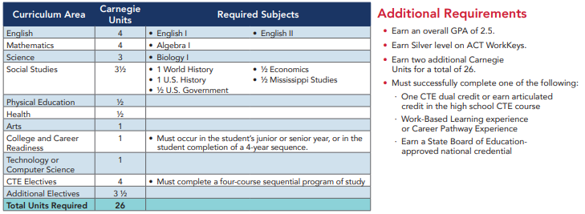
Career & Technical Endorsement

Slide 5
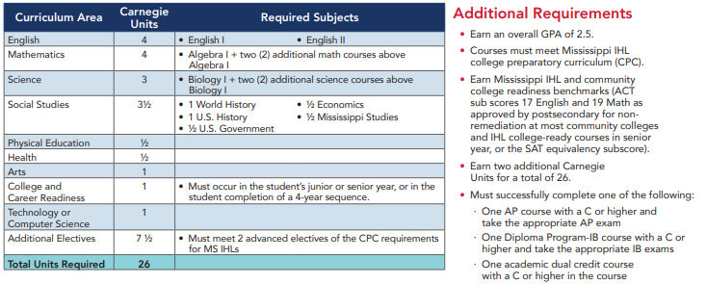
Academic endorsement

Slide 6
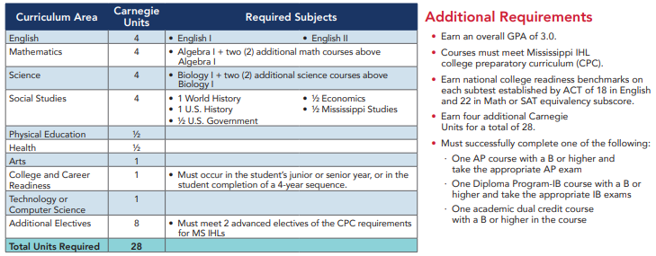
Distinguished academic endorsement

Slide 7
Highlights
Added the College & Career Readiness Course as a requirement for all students.
IHL changed its freshman admission requirements beginning with the Class of 2022 to mirror MDE’s new graduation requirements.
Current Required College Preparatory Curriculum (CPC) = 16 ½ Carnegie Units (Recommended = 19 ½)
Class of 2022
Required CPC = 18 ½ Carnegie Units
Aligns with MDE’s Academic Endorsement.
Increased from today’s by
1 additional math
½ additional social studies
½ additional technology/computer science
Recommended CPC = 20 Carnegie Units
Aligns with MDE’s Distinguished Endorsement
Increased from today’s by
½ additional technology/computer science
* Other IHL admissions changes - Allows for advanced electives to include dual credit & completion of any 2-year CTE course. (Example: completion of both Health Sciences I & II will count as an one advanced elective.) Also, makes distinction between technology courses and computer science courses.

Slide 8
College & Career Readiness Course
Curriculum was created by a task force comprised of individuals from K-12, community colleges, universities, IHL, MCCB, Get2College, and the MS Economic Council.
2018-2019 - There were 38 schools that piloted the course.
All high schools will be offering the course by fall 2019. Training for the course implementation is occurring this summer.
Topics:
Unit 1: Introduction to College and Career Readiness (21st Century Skills)
Unit 2: The Student Portfolio and Exhibit
Unit 3: College Selection and Transition
Unit 4: Applying for Financial Aid
Unit 5: Preparing for a Career and Internship
Unit 6: Financial Literacy
Unit 7: Community Service
Unit 8: Digital Literacy and Citizenship

Slide 9
Questions
Audra Love Kimble
akimble@mccb.edu
601-432-6391

